Slide 1
ROLE AND PURPOSES OF ASSESSMENT IN TEACHING AND LEARNING
TSL3112 LANGUAGE ASSESSMENT
PISMP TESL SEMESTER 6
IPGKDRI

Slide 2
REASONS / PURPOSES OF ASSESSMENT
Assessment instruments (formal or informal) serve multiple purposes.
Commercially designed and administered tests may be used for measuring proficiency, placing students into one of several levels of a course, or diagnosing students’ strengths and weaknesses according to specific linguistic categories, among other purposes.
Classroom-based teacher-made tests might be used to diagnose difficulty or measure achievement in a given unit of a course.

Slide 3
REASONS / PURPOSES OF ASSESSMENT
Specifying the purpose of an assessment instrument and stating its objectives is an essential first step in choosing, designing, revising, or adapting procedure you will finally use.
Tests tend to fall into a finite number of types, classified according to their purposes.

Slide 4
TYPES AND PURPOSES OF ASSESSMENT
Achievement Tests:
To measure learners’ ability within a classroom lesson, unit, or even total curriculum.
Limited to particular material addressed in a curriculum within a particular time frame and offered after a course has focused on the objectives in question.

Slide 5
TYPES AND PURPOSES OF ASSESSMENT
Achievement Tests:
Also serve the diagnostic role of indicating what a student needs to continue to work on in the future, but the primary role is to determine whether course objectives have been met – and appropriate knowledge and skills acquired – by the end of a given period of instruction.
Often summative – administered at the end of a lesson, unit, or term of study.

Slide 6
TYPES AND PURPOSES OF ASSESSMENT
Achievement Tests:
Also play an important formative role – an effective achievement test offers feedback about the quality of a learner’s performance in subsets of the unit or course.

Slide 7
TYPES AND PURPOSES OF ASSESSMENT
Achievement Tests:
The specifications:
The objectives of the lesson, unit, or course being assessed.
The relative importance / weight assigned to each objective.
The tasks employed in classroom lessons during the unit of time.
The time frame for the test and turnaround time.
Its potential for formative feedback.

Slide 8
TYPES AND PURPOSES OF ASSESSMENT
Achievement Tests:
Range from 5- or 10-minute quizzes to three-hour final examinations, with an almost infinite variety of item types and formats.

Slide 9
TYPES AND PURPOSES OF ASSESSMENT
Diagnostic Tests:
To diagnose aspects of a language that a student needs to develop or that a course should include.
For example: a test in pronunciation – the phonological features of English.
Usually, such tests offer a checklist of features for the teacher to use in pinpointing difficulties.

Slide 10
TYPES AND PURPOSES OF ASSESSMENT
Diagnostic Tests:
In comparison:
Achievement tests analyse the extent to which students have acquired language features that have already been taught.
Diagnostic tests elicit information on what students need to work on in the future.
Therefore, diagnostic tests should offer more detailed, subcategorised information on the learner.

Slide 11
TYPES AND PURPOSES OF ASSESSMENT
Placement Tests:
To place a student into a particular level or section of a language curriculum or school.
Usually include a sampling of the material to be covered in the various courses in a curriculum; a student ‘s performance should indicate the point at which the student will find material neither too easy nor too difficult but appropriately challenging.

Slide 12
TYPES AND PURPOSES OF ASSESSMENT
Placement Tests:
Some achievement tests, and proficiency tests can act as placement tests.
Take a formative role – a tally of correct and incorrect responses, categorised by modules in a curriculum, provides teachers with useful information on what may or may not need to be emphasised in the future.

Slide 13
TYPES AND PURPOSES OF ASSESSMENT
Placement Tests:
Many varieties – assessing comprehension and production, responding through written and oral performance, open-ended and limited responses, selection and gap-filling formats – depending on the nature of a programme and its needs.

Slide 14
TYPES AND PURPOSES OF ASSESSMENT
Proficiency Tests:
To test global competence in a language.
To test overall ability.
Traditionally consisted of standardised multiple-choice items on grammar, vocabulary, reading comprehension, and aural comprehension.
Almost always summative and norm-referenced.

Slide 15
TYPES AND PURPOSES OF ASSESSMENT
Proficiency Tests:
Provide results in the form of a single score (and usually two or three subscores, one for each section of a test), which, to many, is sufficient for the gate-keeping role they play of accepting or denying someone passage into the next level of education.
Also, because they measure performance against a norm, with equated scores and percentile ranks taking a paramount importance, they are usually not equipped to provide diagnostic feedback.

Slide 16
TYPES AND PURPOSES OF ASSESSMENT
Proficiency Tests:
A key issue – how the constructs of language ability are specified.
The tasks required to perform must be legitimate samples of English language use in a defined context.
Time-consuming and costly process.

Slide 17
TYPES AND PURPOSES OF ASSESSMENT
Aptitude Tests:
To measure capacity or general ability to learn a foreign language a priori (before taking the course) and ultimate predicted success in that undertaking.
Ostensibly designed to apply to the classroom learning of any language.
Enjoyed the widespread use once, but no longer now.

Slide 18
TYPES AND PURPOSES OF ASSESSMENT
Aptitude Tests:
For example – the Modern Language Aptitude Test (MLAT) and Pimsleur Language Aptitude Battery (PLAB) in the USA:
Students’ performing language-related tasks such as number learning, distinguishing speech sounds, detecting grammatical functions, and memorising paired associates.
The tests show some significant correlations with ultimate performance of students in language courses.

Slide 19
TYPES AND PURPOSES OF ASSESSMENT
Aptitude Tests:
However, those correlations presuppose a foreign language course in which success is measured by similar processes of mimicry, memorisation, and puzzle-solving.
No research to show unequivocally that those kinds of tasks predict communicative success in a language.

Slide 20
TYPES AND PURPOSES OF ASSESSMENT
Aptitude Tests:
Because of these limitations, standardised aptitude tests are seldom used today.
Instead, attempts to measure language aptitude more often provide learners with information about their preferred styles and potential strengths and weaknesses, and strategies to overcome the weaknesses.

Slide 21
ASSESSMENT AND LEARNING
Tests are a subset of assessment, but not the only form of assessment.
Does all teaching involve assessment?
Are teachers constantly assessing students with no interaction that is assessment-free?

Slide 22
ASSESSMENT AND LEARNING
For optimal learning to take place, students in the classroom must have freedom to experiment, to try out their own hypotheses about language without feeling that their overall competence is being judged in terms of those trials and errors.
Learners must have opportunities to play with language in a classroom without being formally graded.

Slide 23
ASSESSMENT AND LEARNING
Also for learners to listen, think, take risks, set goals, and process feedback from the teacher and then recycle through the skills that they are trying to master.
At the same time, teachers are indeed observing students’ performance, possibly taking measurements, offering qualitative feedback, and making strategic suggestions.

Slide 24
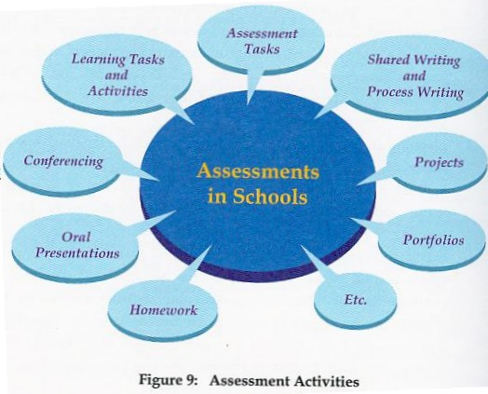

Slide 25
ASSESSMENT AND LEARNING
Assessment for learning is diagnostic and formative for the purposes of greater learning achievement .
Assessment of learning is assessment for purposes of providing evidence of achievement for reporting.

Slide 26
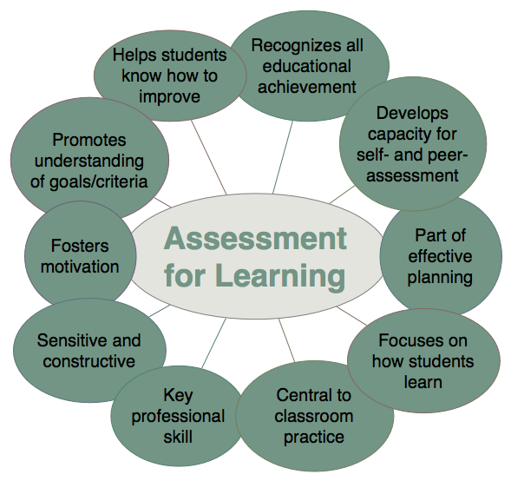

Slide 27
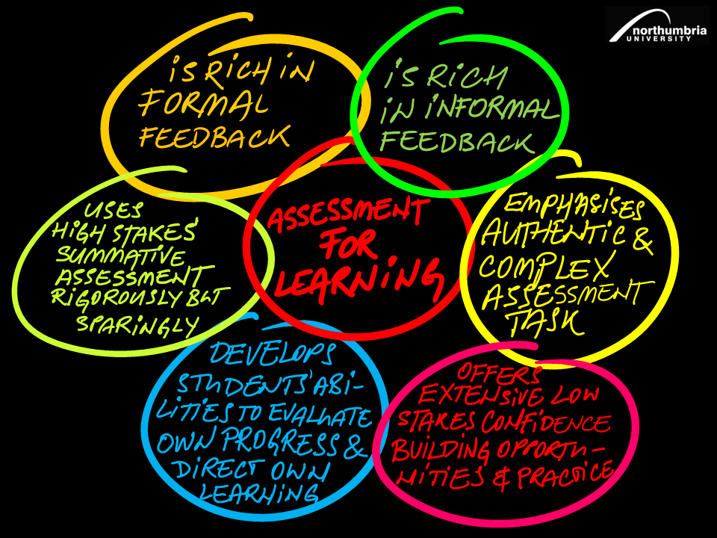

Slide 28
ASSESSMENT AND LEARNING
Assessment for learning | Assessment of learning
Assessment for learning is ongoing, diagnostic, and formative. It is for ongoing planning. It is not used for grading and Report Cards. | Assessment of learning occurs at end of year or at key stages. It is summative. It is for grading and Report cards.
diagnostic and formative teacher assessment, student self-assessment, and/or student peer assessment | summative teacher assessment may be either criterion-referenced (based on prescribed learning outcomes) or norm-referenced (comparing student achievement to that of others)

Slide 29
ASSESSMENT AND LEARNING
Assessment for learning | Assessment of learning
criterion-referenced – criteria based on prescribed learning outcomes identified in the provincial curriculum, reflecting performance in relation to a specific learning task involves both teacher and student in a process of continual reflection and review about progress teachers adjust their plans and engage in corrective teaching in response to formative assessment | information on student performance can be shared with parents/guardians, school and district staff, and other education professionals (e.g., for the purposes of curriculum development) used to make judgments about students’ performance in relation to provincial standards used for grading and Report Cards

