Slide 1
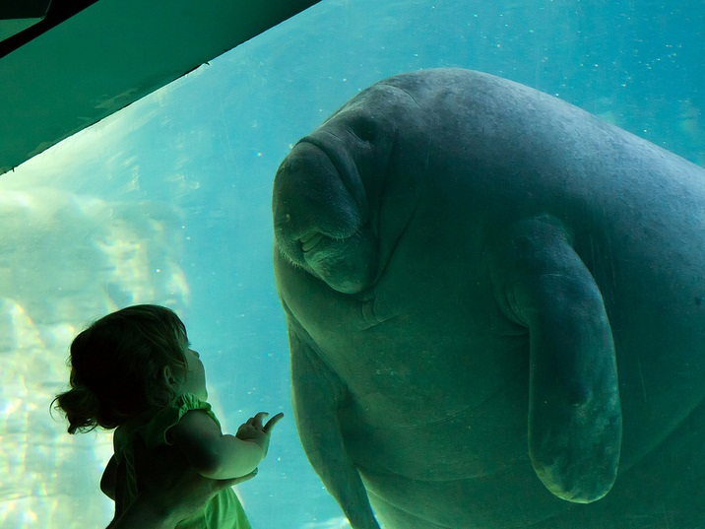
The English Sound System
Reading and Pronunciation

Slide 2
What is the Phonology?
Phonetics all of the sounds
Phonemics significant sounds
Phonics teaching reading sounds
Notes:
Confusion frequently exists regarding the use of these three similar words.
When a linguist studies ‘phonetics’ they examine ALL of the different sounds in a language.
For example, in English there are (at least) 2 ‘p’ sounds. One is an unreleased [p] like at the end of a word ‘hop’. The other is an aspirated sound like at the beginning of a word such as ‘pit’. You can demonstrate the difference by putting a piece of paper in front of your lips when you say them and noticing the puff of air with the aspirated sound.
In some languages this is a significant difference and there are ‘minimal pairs’ to prove it. (Two words with different meanings, the only difference being in the pronunciation of the ‘p’.) In English it is not significant, it is not a phonemic difference, and so both sounds can be represented by the one symbol ‘p’.
Traditionally, phonetic symbols are placed in square brackets [p], phonemic symbols in slash brackets /p/.
Phonics is about teaching children to read by ‘sounding out’ words.

Slide 3
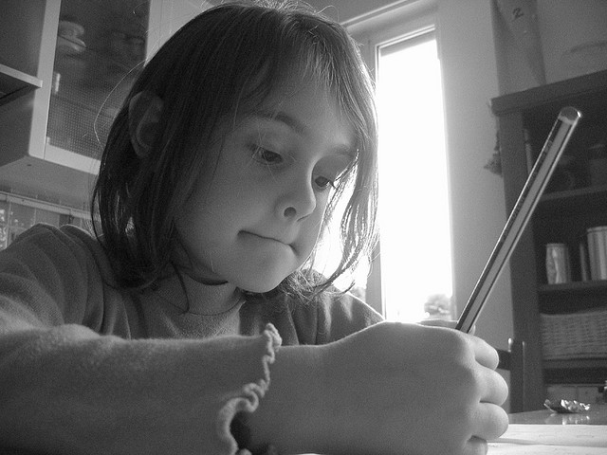
Spelling
Writing words correctly
Synonyms
Homonyms
Antonyms
Homophones
Heteronyms
Homographs

Slide 4
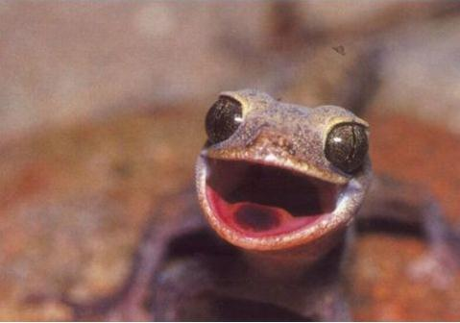
Phonology describes how to use your...
teeth
tongue
lips
palate
uvula
larynx
Maybe that’s why lizards can’t talk ...
Notes:
Phonology – the study of sound – describes how we use all of our mouth parts to articulate a particular sound. Your tongue interacts with your teeth, and the ‘alveolar ridge’ behind your teeth, your palate, and your lips. The air can be stopped and then released, or allowed to slowly push past. Some sounds vibrate through your nose. Your uvula (the little thing hanging at the back in your throat) can also get involved, and your larynx (voice box) engages for some sounds and not others. You can breathe in or out, and use lung or mouth air, and even use clicking sounds with your teeth and/or tongue. All of these are parts of someone’s language.

Slide 5
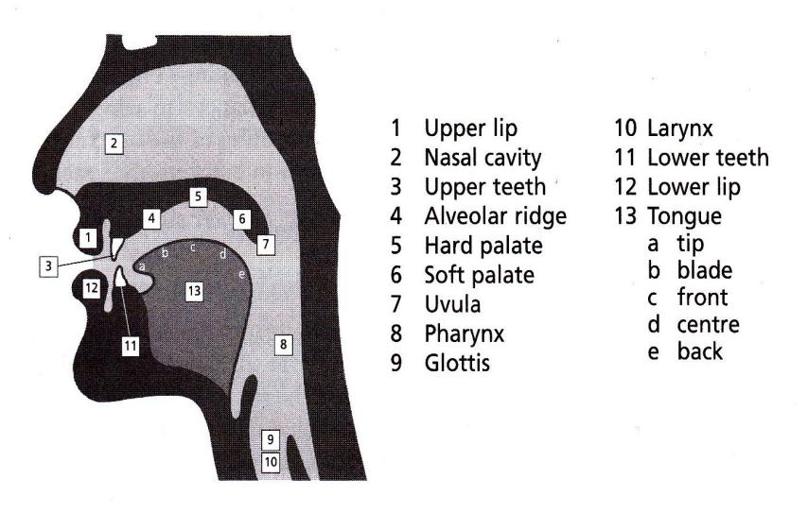
Inside Your Head!
We use ALL of these to speak.
Notes:
Here is a chart showing the parts of your head that are involved in speech, and which can be included in an explanation of any one sound.
We are going to briefly describe each of the English phonemes (significant sounds).

Slide 6
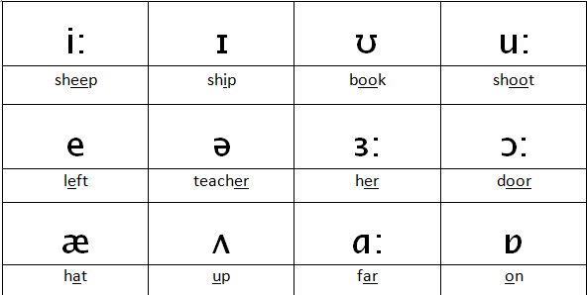
Simple Vowels

Slide 7
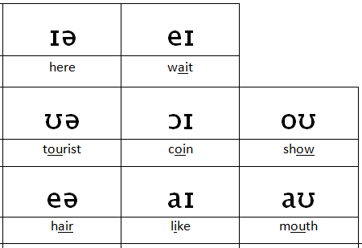
Diphthongs

Slide 8
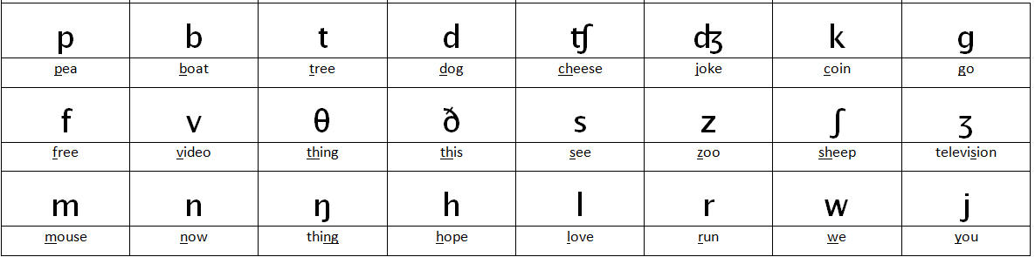
Consonants

Slide 9
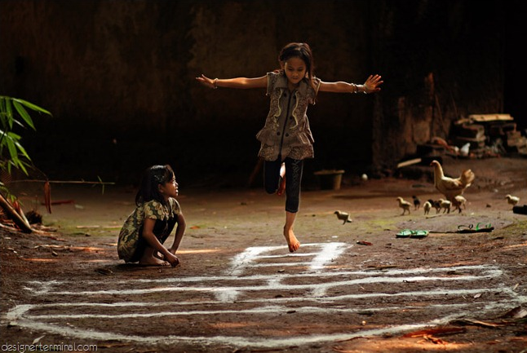
Practice!

Slide 10
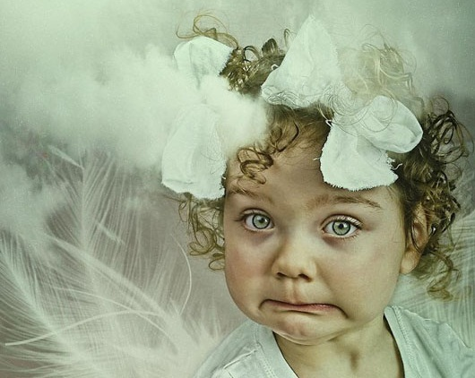
English Pronunciation:
Word
Stress!

Slide 11
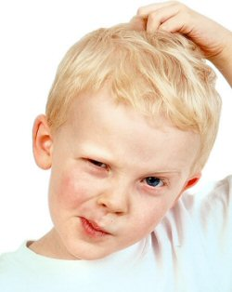
Speak clearly to be understood
Incorrect stress
can cause misunderstanding just as much as incorrect sounds.

Slide 12
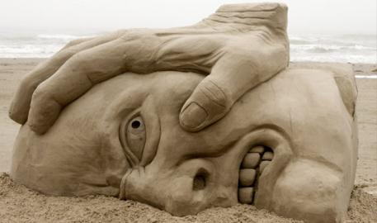
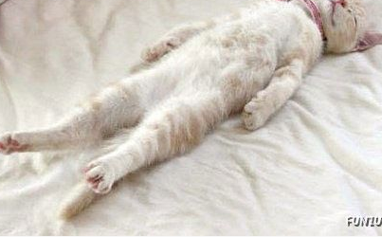
Stress and Unstress
What does STRESS sound like?
Louder
Longer
Higher

Slide 13



What does UNSTRESS sound like?
/ə/
er
ar
or
ure
teacher
collar
doctor
measure
a
e
i
o
u
zebra
garden
fossil
lion
circus

Slide 14

Stress on the 1st syllable:
MOST 2-syllable nouns and adjectives have stress on the FIRST syllable.
BUTter
SANDwich

Slide 15
Stress on the LAST Syllable
MOST 2-syllable verbs
have stress on the LAST syllable.
diVIDE
reCEIVE

Slide 16
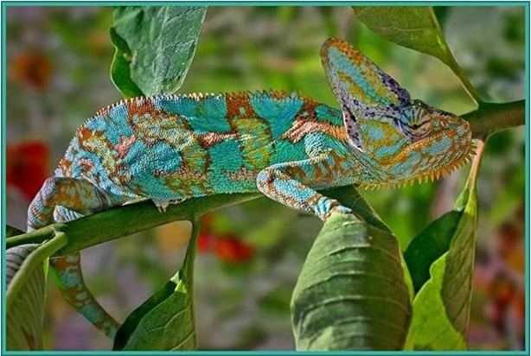
Word Stress that Changes
Some 2 syllable words change stress
depending on whether they are used as an adjective or a noun,
or a verb.

Slide 17
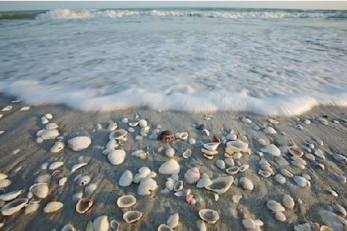
compound
present
export
object
decrease
transport
address
frequent
conduct
combat
protest
insult
content
desert
perfect
permit
These are called heteronyms

Slide 18
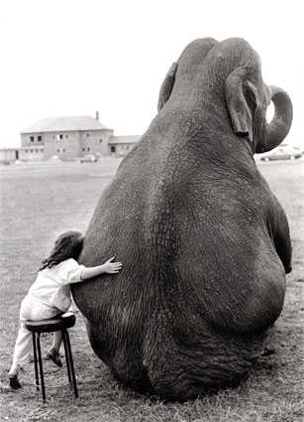
Rules for Longer Words:
Stress is attracted to certain syllables:
The stress falls on the syllable just before ...
-ic
-tion
-sion
-cion
-xion

Slide 19
So where is the stress?
calculation decision
reaction solution distribution delusion
relation association operation

Slide 20
So where is the stress?
calculation decision
reaction solution distribution delusion
relation association operation

Slide 21
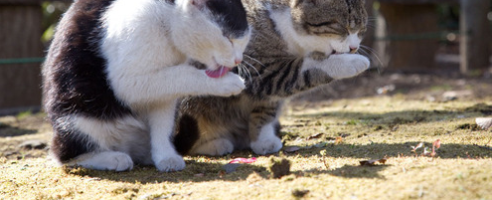
What is the pattern here?
economic terrific
strategic logic
pathogenic domestic
metabolic statistic

Slide 22

What is the pattern here?
economic terrific
strategic logic
pathogenic domestic
metabolic statistic

Slide 23
Where is the stress?
biology biological
policy political
geography geographical
university managerial
photography photographical
society sociological
technology technological
electricity electrical

Slide 24
Where is the stress?
biology biological
policy political
geography geographical
university managerial
photography photographical
society sociological
technology technological
electricity electrical
Rule for the left column?

Slide 25
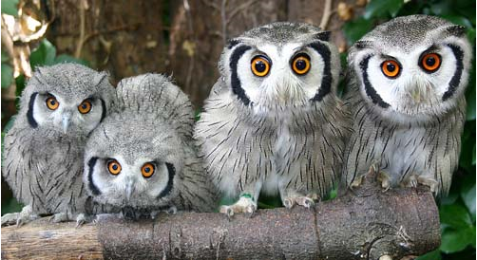
What do they have in common?
And where is the stress?
biology policy
geography university
photography society
technology electricity

Slide 26
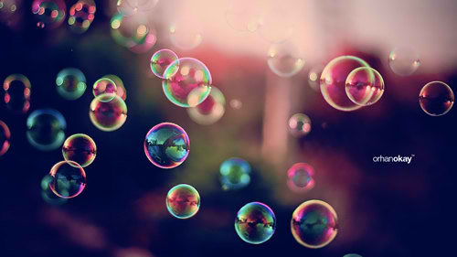
“3rd Last” Rule:
For words that end in consonant + y
-cy
-gy
-fy
-ty
-phy
* not -ly
Stress falls on the third last syllable.

Slide 27

More examples
quality
choreography
democracy
archaeology
atrophy
equality
clarify
allergy

Slide 28
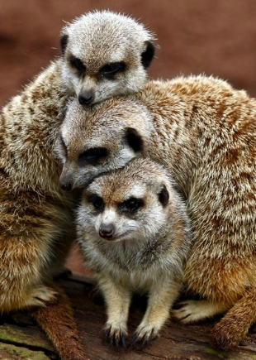
Another “3rd Last” Rule:
In words that end in
-ise / -ize
-ate
stress falls on the
3rd last syllable.

Slide 29
Some –ise / ize examples:
accessorise acclimatise idolise advertise
agonise anesthetise anodise antagonise
apologise brutalise legalise computerise
magnetise globalise mobilise traumatise
organise dramatise emphasise energise
epitomise fantasise fertilise finalise

Slide 30
Some –ate examples
generate certificate passionate
graduate advocate separate
appropriate estimate associate
concentrate illustrate participate
immediate corporate chocolate
negotiate communicate accommodate
advocate anticipate delegate
Some of these are heteronyms

Slide 31
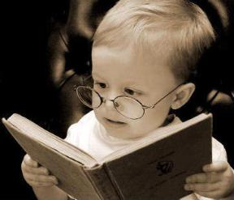
Revision:
2 syllable nouns/adjectives: stress penultimate syllable (2nd last). (many exceptions)
2 syllable verbs: stress ultimate (last) syllable. (most)
Stress before –ic
Stress before –tion (-sion, -cion, -xion)
Stress on ante-penultimate syllable (3rd last) for words that end in:
    consonant plus y, (not –ly)
    -ise (/-ize),
    -ate

Slide 32
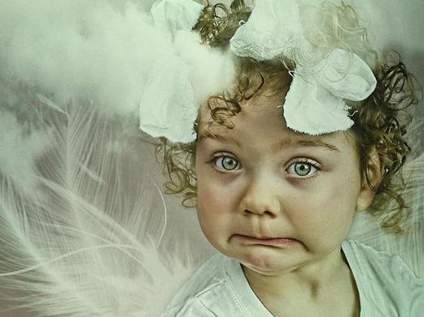
English Pronunciation
Sentence Stress
By Ruth Wickham, Training Fellow, IPGKDRI

Slide 33
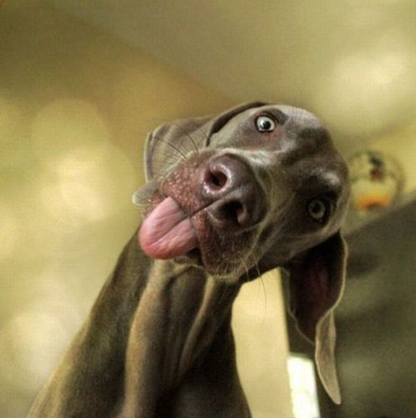
For people to understand your English
stress can be more important than pronunciation.

Slide 34
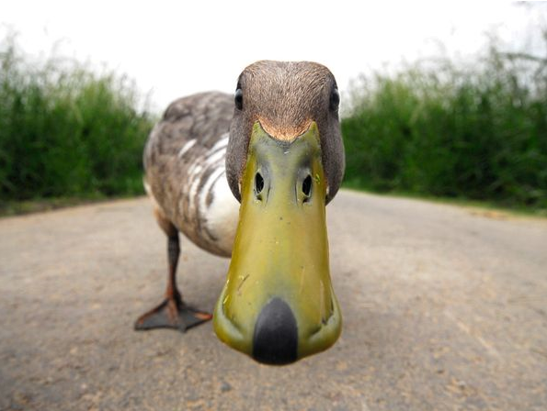
The MEANING is in the Stress
To CORRECT information
To CHECK information

Slide 35
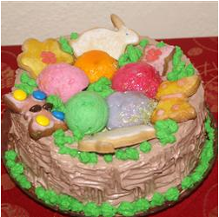
The
Meaning
is in the
Stress
For example
Notes:
Try identifying meaning from some rhythms.

Slide 36
One Sentence, Different Meanings
Are you going to eat THAT?
[Meaning: it’s so big! / it’s disgusting!]
Are you going to EAT that?
[Meaning: I’m not sure that it’s really ‘food’!]
Are YOU going to eat that?
[Meaning: I thought you bought it for me!]
ARE you going to eat that?
[Meaning: you are sitting here just looking ...]

Slide 37

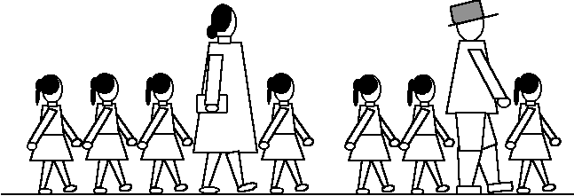
English is stress-timed rather than syllable-timed
Chinese Rhythm
English Rhythm

Slide 38
Stress-Timed Language
Dogs chase cats
The dogs chase cats
The dogs chase the cats
The dogs will chase the cats
The dogs will be chasing the cats

Slide 39
♫Beat and Rhythm ♫
I was talking to Brian when I ran into Sue.
I was waiting for Jack when I saw Mary Lou.
They were cleaning the house when I knocked at the door.
He was dusting a lamp when it fell on the floor.
She was learning to drive when I met her last May.
She was buying a car when I saw her today.

Slide 40
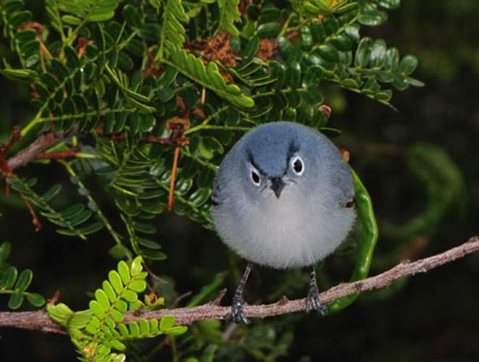
INTONATION
in spoken English
by Ruth Wickham, Training Fellow, IPGKDRI

Slide 41


Stress and Unstress ...
‘Stressable’ words
Not ‘Stressable’
Content/Stressed Words
verbs
nouns
adjectives
adverbs
question words
prepositional adverbs
negatives
Function/Unstressed Words
modal auxiliaries
articles
conjunctions
prepositions
pronouns

Slide 42
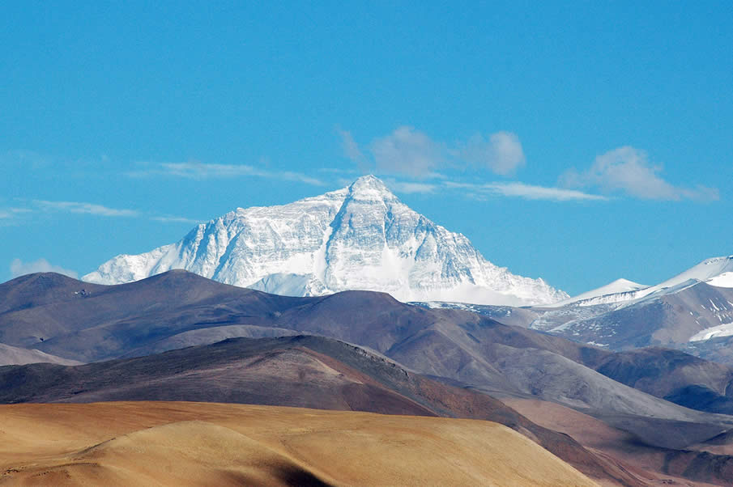
Tonic Syllable
The Tonic Syllable (the peak) is almost always found in a content word in utterance final position.
peak
I'm going.
I'm going to London.
I'm going to London for a holiday.
I'm going to London for HOliday.
Tonic syllable

Slide 43
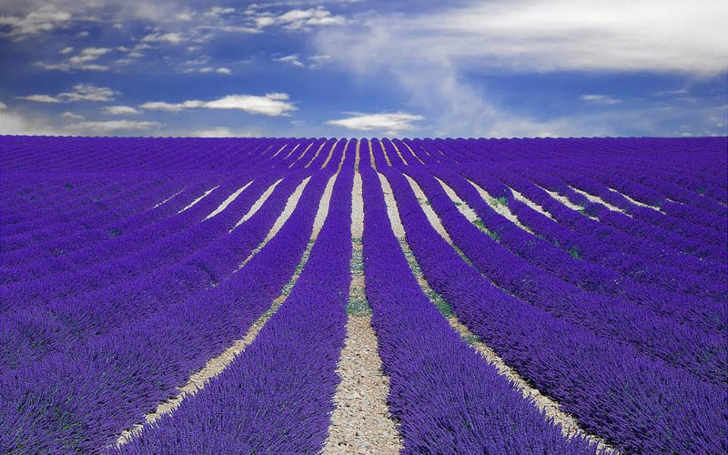
Where is the Tonic Syllable?
Fast automobiles make dangerous friends.
Variety is the spice of life.
Why don't we catch a film tonight?
Janet silently turned the page.
I'll make sure to give him a ring the next time I'm in town.

Slide 44

Emphatic Stress
For emphasis, the tonic syllable moves from its utterance final position .
It usually falls on a modal auxiliary, an intensifier, or an adverb.
It was very BORing.
You mustn’t talk so LOUDly
It was VEry boring.
You MUSTn’t talk so loudly

Slide 45

Say each of these with Emphatic Stress.
Fast automobiles make dangerous friends.
Variety is the spice of life.
Why don't we catch a film tonight?
Janet silently turned the page.
I'll make sure to give him a ring the next time I'm in town.

Slide 46
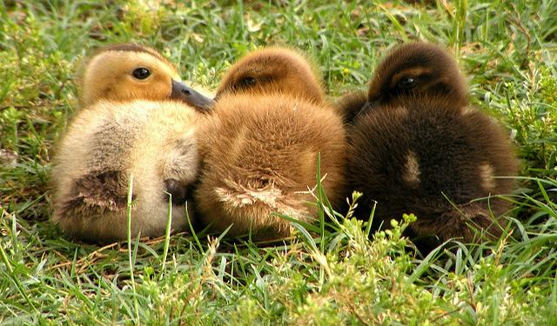
Contrastive Stress
Any word – can be content or function

Slide 47
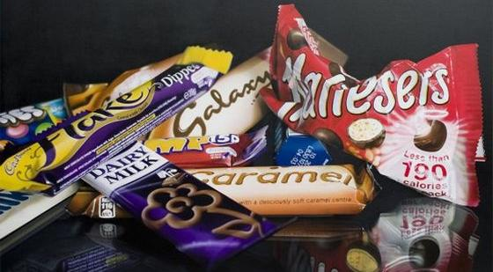
Use contrastive stress on these.
David stole the money, not Mike.
2. David stole the money. He didn't have permission.
3. I haven't seen the film. David has.
4. David stole the money. He didn't touch the jewellery.
5. Mike's birthday is on the twenty-eighth, not the twenty-fourth.
(Sometimes there is more than one possible answer.)

Slide 48
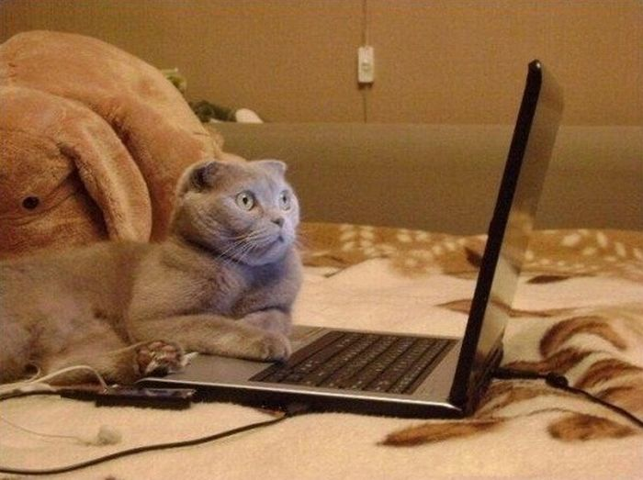
New Information Stress
Responding to a ‘Wh-’ question, the ANSWER is stressed:
a) What's your NAME
b) My name's GEORGE.
a) Where are you FROM?
b) I'm from WALES.
a) Where do you LIVE?
b) I live in BONN.
a) What do you DO?
b) I'm a STUdent.
a) When does the school term END?
b) It ends in MAY.

Slide 49
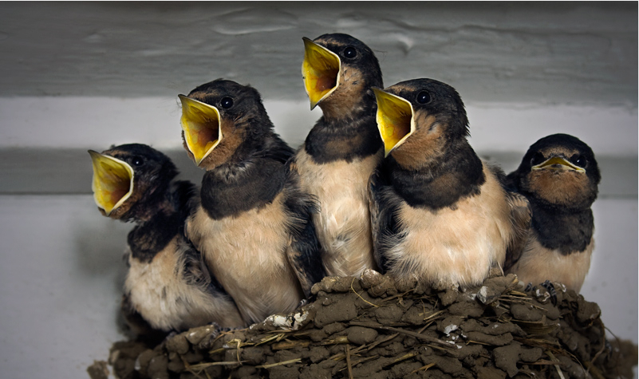
Intonation

Slide 50
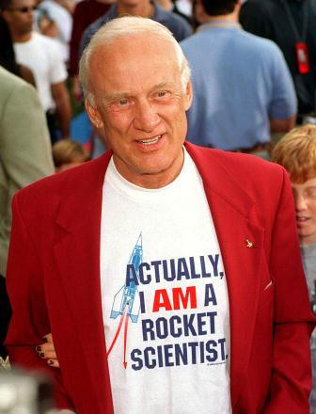
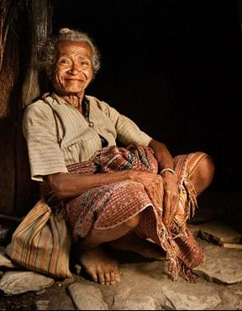
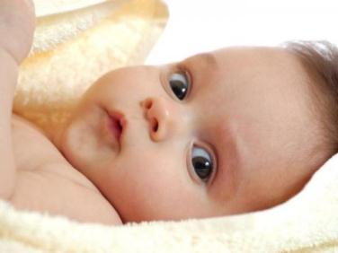
Hello!
Hello.
Hello!

Slide 51
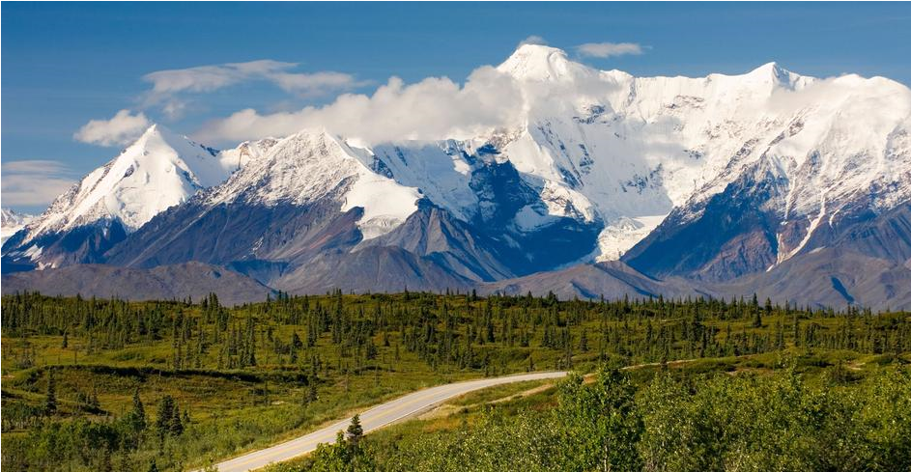
Tonal Patterns in English
Four main patterns:
Fall
High - rise
Low - rise
Fall - rise

Slide 52
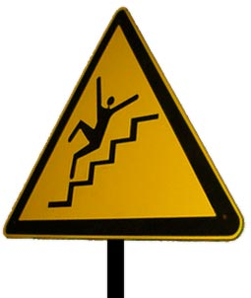
Fall
time for response
completion
finality

Slide 53
Fall examples:
Punishment and referral:
Requests or orders:
I’ll report you to the poLICE.
Please sit DOWN
I’ve spoken to your PARents.
Call him IN.
‘Wh-’ questions:
Exclamations:
Where is the PENcil?
Watch OUT!

Slide 54
Fall examples (2):
Yes / No question ...
You like it, DON’T you?
if the speaker already knows
the answer,
YES.
or is sure of a ‘yes’ answer.
Have you MET him?
YES

Slide 55
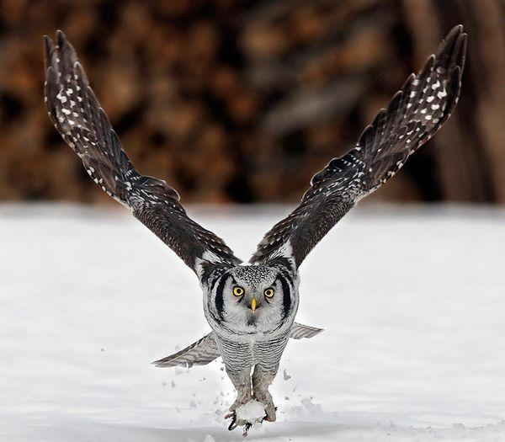
Low – Rise (rising tone)
Yes / No questions when the answer is not known:
A: Isn’t he NICE?
A: Do you want some COFFee?
B: Yes.
B: No.
B: I don’t know.
A: Do you take CREAM in your coffee?

Slide 56

High Rise (rising tone)
The Tonic has extra pitch height.
The speaker is asking for repetition, or clarification,
or indicating disbelief.
I’m taking up TAXidermy this autumn.
Did you notice the emphatic stress here?
Taking up WHAT? (clarification)
She passed her DRIving test.
She PASSED? (disbelief)

Slide 57

Fall - Rise
Very often a regional or personal variation:
Sometimes used for checking a list ...
British: Sometimes it can imply that we mean something different from what we are saying:
Yeeesss
I’d like a cake.
(Well, maybe)
(But I probably won’t have one.)

Slide 58
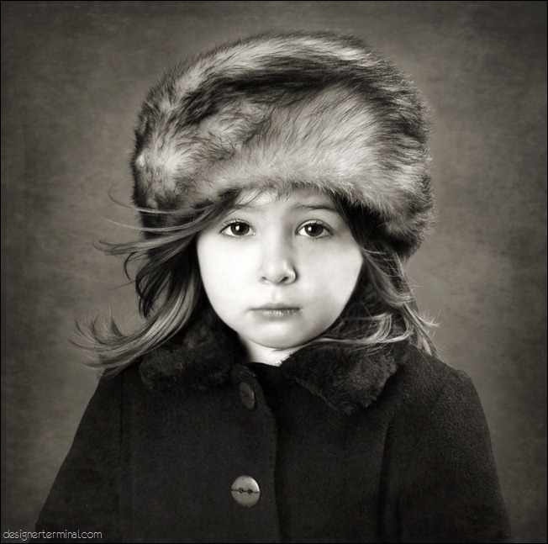
How to show stress
∥ \↗ My name is POLLi.∥
∥ \↗I came from RUSSia.∥

Slide 59
Dictation!
Write down:
1. words
2. stress
3. intonation

Slide 60

Pitch
The pitch moves up and down, within a 'pitch range'.
Everybody has their own pitch range.
Languages, too, differ in pitch range. English has particularly wide pitch range.

Slide 61
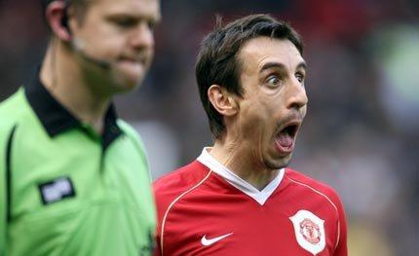
High Pitch – Emotional!
Try saying this with a high pitch:
What did you do to my car?

Slide 62
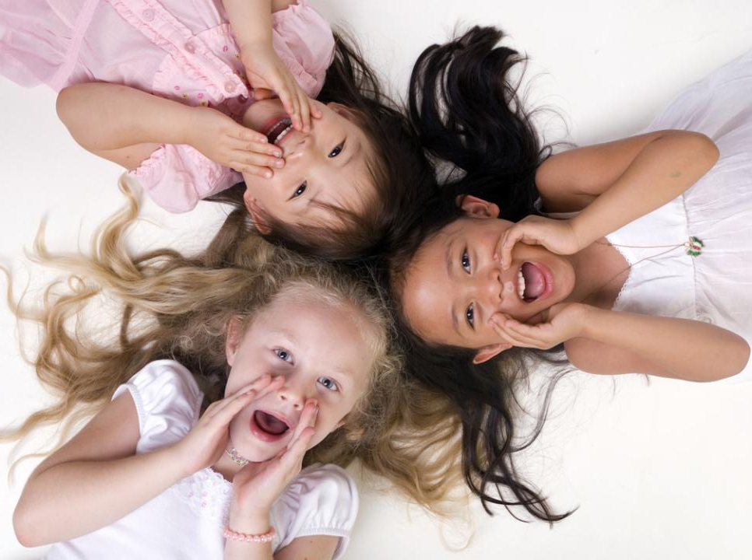
Group Work
Think of something you might say with a high pitch.

Slide 63
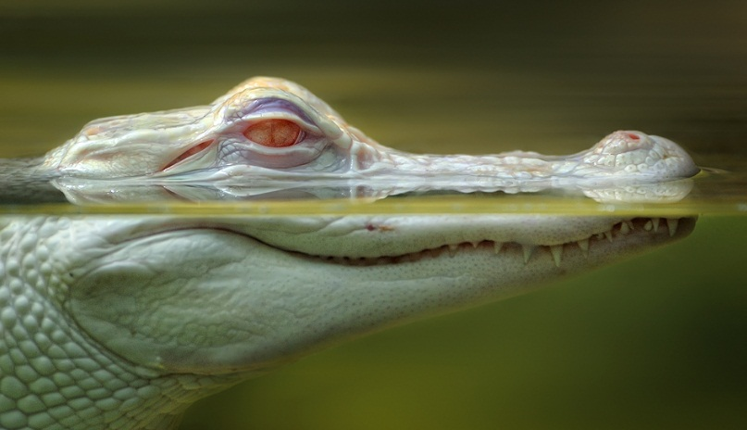
Low Pitch – additional information
Almost like it doesn’t really matter if anyone actually hears it.

Slide 64
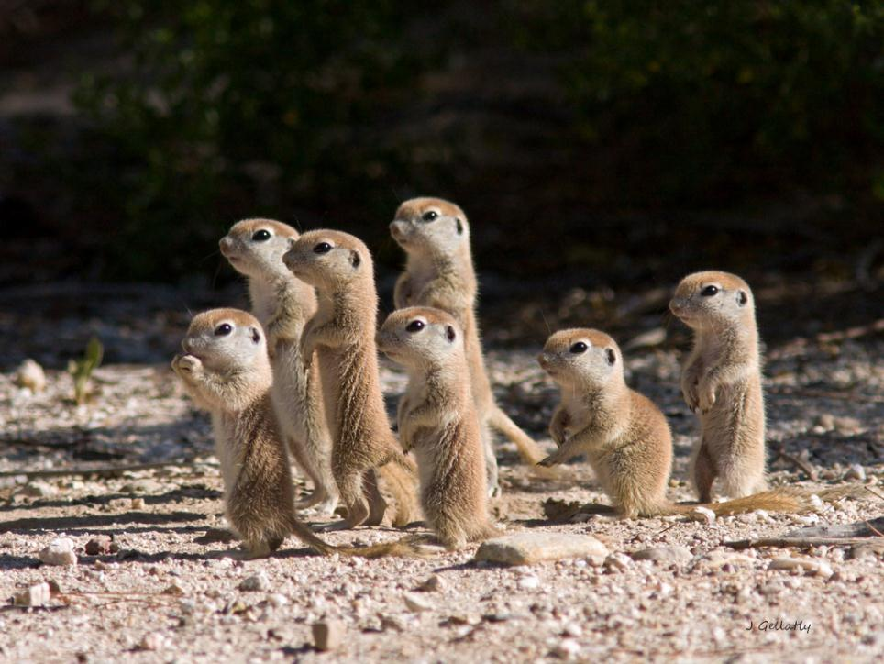
There are no simple rules for Intonation.

Slide 65
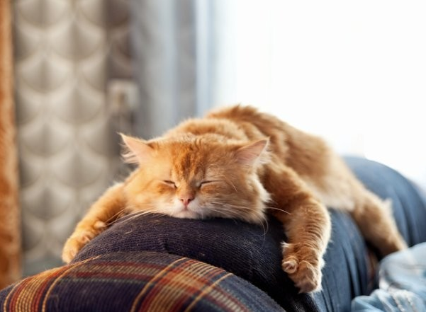
Well done!

