Slide 1
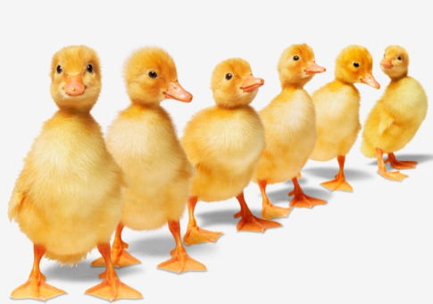
Grammar
Techniques for teaching
Notes:
Grammar is all about getting your ducks in a row – seeing and understanding patterns in language.

Slide 2
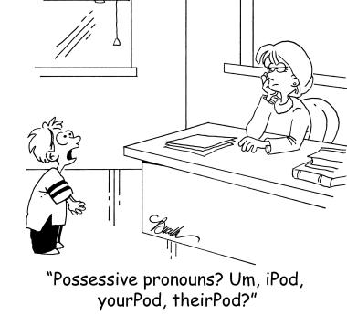
What is Grammar?
Notes:
What is “Grammar”?
How important is grammar in learning a language?
Is it possible to learn a language well without learning the grammar?
What is the easiest way to teach grammar?

Slide 3
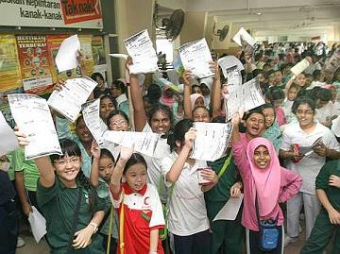
Grammar rules for passing exams
The main reason for learning grammar rules is to pass exams.
Knowing the rules has little or no effect on language proficiency.
Natural language learning does not involve learning rules.
However students need to learn rules simply to pass exams.
Notes:
The main reason for learning grammar rules is to pass exams.
Knowing the rules has little or no effect on language proficiency.
Natural language learning does not involve learning rules.
However students need to learn rules simply to pass exams.

Slide 4
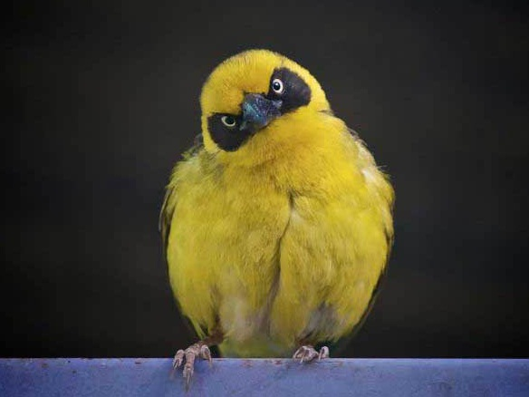
So …. What’s the Point?
Notes:
The Techniques we are going to talk about today are more effective than drilling the rules because:

Slide 5

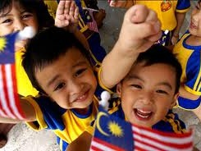
1. Defeat Boredom
Notes:
1. They Defeat Boredom.
With a variety of activities children are motivated.

Slide 6

Save the teacher’s sanity too
Notes:
The teacher (you) is also less likely to become frustrated.

Slide 7
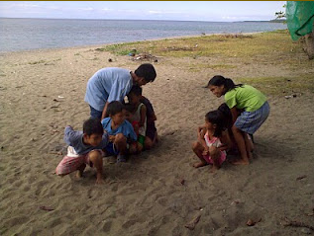
2. Encourage Natural Learning
Notes:
2. They Encourage Natural Learning
In fact these activities are good for all areas of language learning – especially listening and speaking – as they develop the students’ natural language learning skills.

Slide 8

3. Practise rules (for the exam)
But in an interesting way!
Notes:
3. They Can Still Practise the Grammar Rules.
These strategies provide for more interesting ways to practise the rules - which they need to know in order to pass their exams.
NOTE: The six techniques below overlap with each other, and are also useful in all the other areas of English teaching including Listening, Speaking, Reading, Writing and Language Arts.

Slide 9
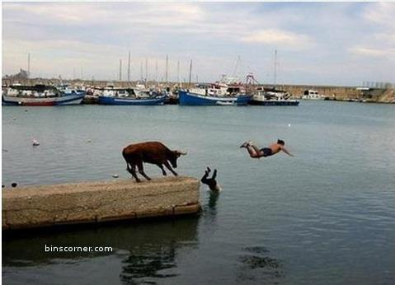
1. Stories
““Tell me a fact and I’ll learn. Tell me the truth and I’ll believe. But tell me a story and it will live in my heart forever.”
Notes:
The KSSR is built on three broad themes – The World of Self, Family and Friends, The World of Stories, and The World of Knowledge. But that does not mean that stories can only be used in lessons related to “The World of Stories” theme. Stories can (and really should) be part of every lesson in every area of the curriculum. In the words of the old Indian proverb:
“Tell me a fact and I’ll learn. Tell me the truth and I’ll believe. But tell me a story and it will live in my heart forever.”
Take a moment to think about this statement. Answer the questions and briefly discuss with your group.

Slide 10
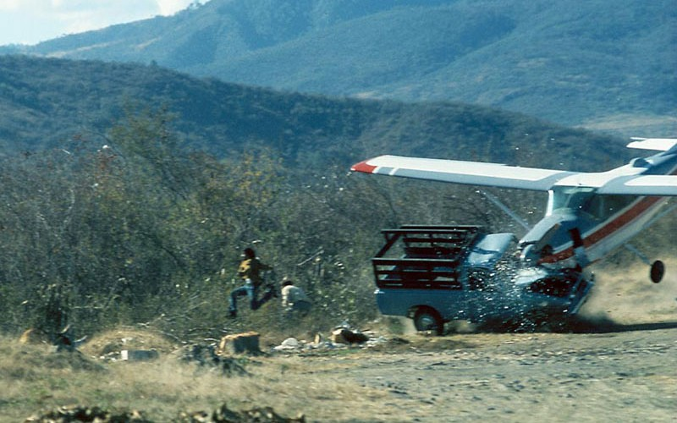
Strategies for Using Stories
Notes:
Strategies for using stories
Start with a story, any story – traditional, from a modern storybook, or just made up on the spot.
Read or tell the story to the children, and include pictures, actions, and sound effects – whatever it takes to make the story understandable and enjoyable.
As you do so draw attention to and emphasise the grammar point that you want them to notice. Maybe add more of that type of example to the story as you go.
For example:
Articles – definite and indefinite.
Adjectives
Comparatives and Superlatives
Tenses
Imperative
Modals
You can encourage the children to join in as they notice a pattern, or contribute ideas (of other adjectives, for example, as they look at the pictures), or you can include some sort of short chant (such as maybe a grammar rule) for them to join in with.
Re-tell the story (and / or get the students to retell it) and make changes to emphasise your grammar point.
For example:
Change the tense of the story – present to past or future
Change the adjectives, or make them all superlatives
Change the story all to imperative, or interrogative
Change the point of view of the story – 3rd person to 1st person maybe
Activity 1:
With a partner, look at the brief story outline you have been given.
1. Decide how you can tell the story to emphasise a particular Grammar point of your choosing.
2. Decide how you can change the story to bring out the same or a different grammar point.
Prepare to present your story with one of you telling it one way and the partner telling the changed version.

Slide 11
Choose or make up a story
Aladdin and the Wonderful Lamp | Ali Baba and the Forty Thieves
Beauty and the Beast | Chicken Little
Cinderella | Dick Whittington and His Cat
Hansel and Gretel | Jack and the Beanstalk
Jack the Giant Killer | Puss in Boots
Rapunzel | Red Riding Hood
Rumpelstiltzkin | Sindbad the Sailor
Sleeping Beauty | Snow White and the Seven Dwarfs
Snow White and Rose Red | The Brave Little Tailor
The Emperor's New Clothes | The Frog Prince
The Gingerbread Man | The Golden Goose
The Little Match-Girl | The Little Mermaid
The Magic Carpet | The Musicians of Bremen
The Nightingle | The Pied Piper of Hamelin--Peppers
The Princess and the Pea | The Shoemaker and the Elves
The Six Swans | The Snow Queen
The Sorcerer's Apprentice | The Steadfast Tin Soldier
The Three Bears | The Three Little Pigs
The Tinderbox | The Town Mouse and the Country Mouse
The Ugly Duckling | Three Billy Goats Gruff
Thumbelina | Tom Thumb
Twelve Dancing Princesses

Slide 12



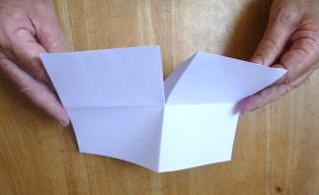

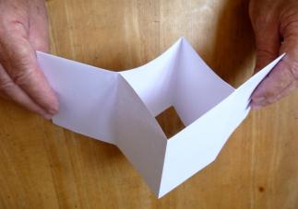
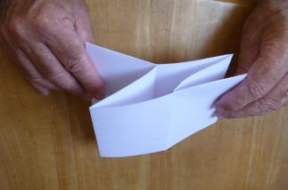
Make a Little
Book

Slide 13
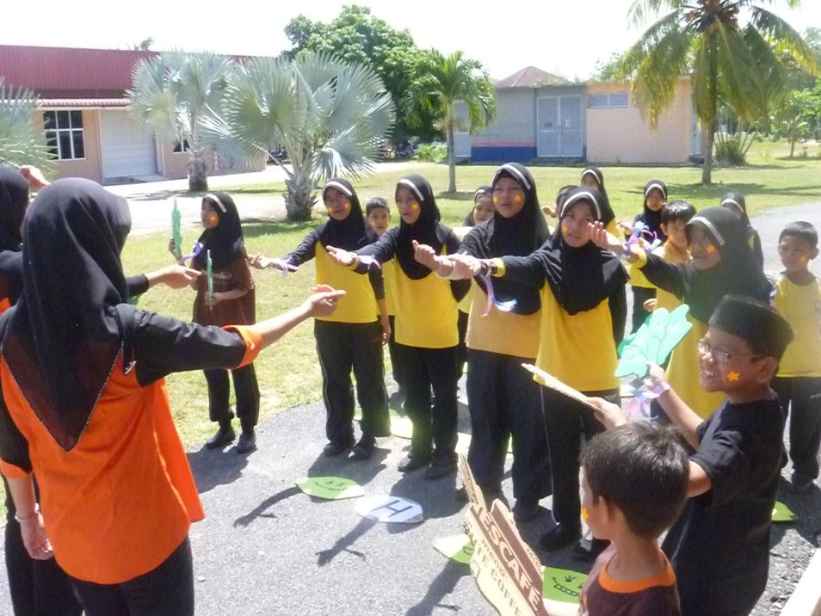
2. Songs and Chants
Notes:
Some songs tell a story, and some stories contain a song.
Learning a story song can have the same benefits of a story with the added advantage that somehow when we learn something that includes music we remember it better, it ‘sticks’ in your mind.
a) Using traditional songs
Traditional songs are simple, rhythmical and often repetitive, and often have fun actions and sound effects which children enjoy. As children learn the song, the inherent grammar rules can be pointed out to them. As with the story, with some songs you can change parts of the song to emphasise particular grammar points.
Activity
In your group, look at the traditional song you have been given. Make sure you all know the tune and how the song ‘goes’.
Look for Grammar features that could be taught using the song.
What could be altered in the song to emphasise your point or bring out a new point?
Be ready to present your song.

Slide 14
Choose a Song
Frere Jacques / Are you sleeping 5 little ducks
Auld lang syne 10 in the bed
Farmer in the dell Alison’s Camel
Happy birthday Bear went over the mountain
Clementine B.I.N.G.O
Here we go round the mulberry bush Grand old Duke of York
Hokey Pokey I met a bear
I’m a little teapot Long legged sailor
If you’re happy and you know it On top of spaghetti
London Bridge is falling down Sailor went to sea
Mary had a little lamb Hole in my bucket
Old MacDonald had a farm To market to market
Row, row, row your boat Skip to my Lou
This old man Wheels on the bus
Where is Thumbkin Brown girl in the rain

Slide 15
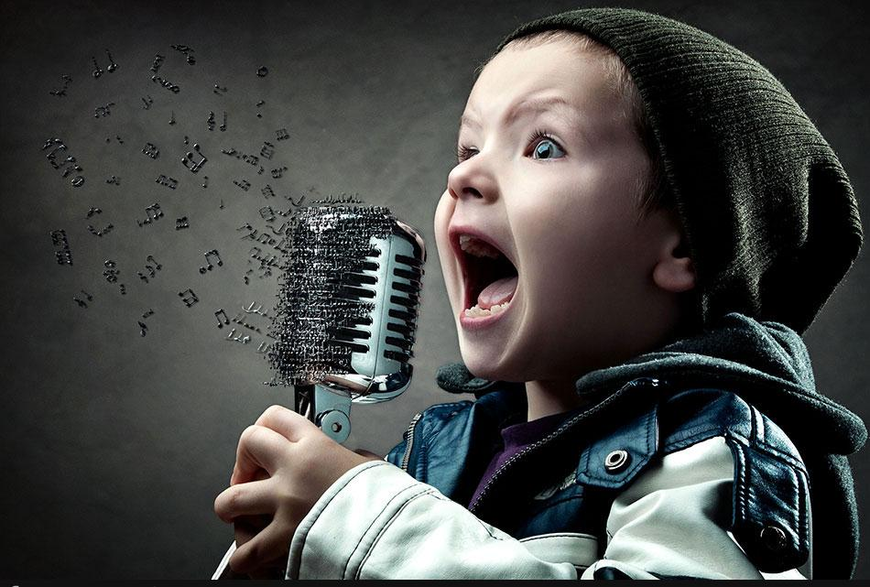
A Song as a Text
Notes:
b) A song as a text
You can have the children listen to a commercial song, and then examine the words in a worksheet and do exercises involving the words, just like you would with a reading text except that they get to learn the song (where they are unlikely to choose to memorise sections of a written text).
Of course with young children, from year 3 and upwards, we need to be careful about selecting suitable songs, and there is not a lot of point if the background music blurs out the song words either.
To find a song that has a particular phrase or sentence use the website: http://lyreach.com
You simply type in the words you are hoping to find, and it comes up with a list of songs, and links to the songs.

Slide 16
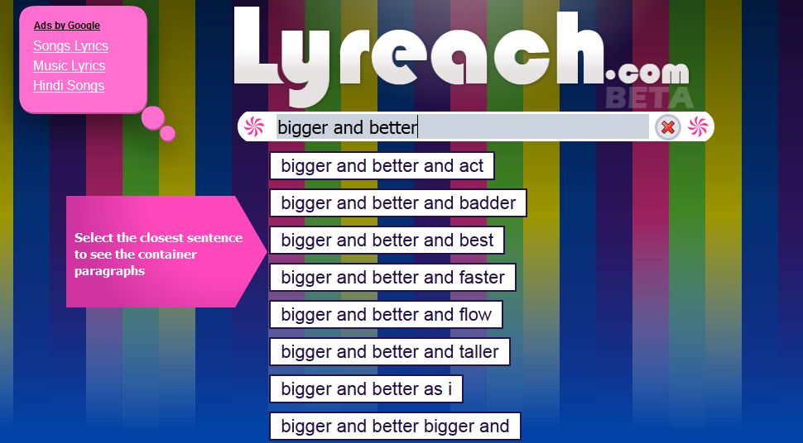
Find a song with particular words

Slide 17
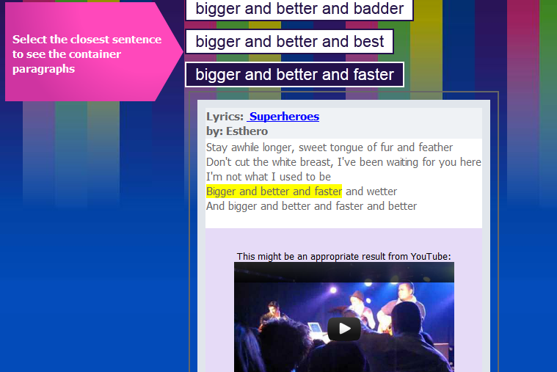
Look at the song carefully

Slide 18
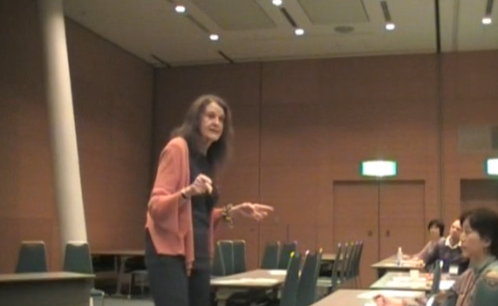
Chants
Carolyn Graham
Notes:
Chants take advantage of the rhythm and rhyme of a song, without the complication of a tune. For this reason at least, it is very easy to create our own chants.
(Books of “Jazz Chants” are also available commercially by Carolyn Graham, and sometimes you can find her raps and chants online.)
Vocabulary Chants
A vocabulary chant is the simplest to create. In the context of Grammar learning, this may involve learning a group of words that are all a particular type – such as adjectives – or it may involve a selection of grammar terms – such as past, present, future.
Activity
With a partner, create a vocabulary chant using the following steps.

Slide 19



Vocabulary Practice
1. Choose your theme:
school
animals
food
sport
music
transport
occupations

Slide 20
Vocabulary - animals
Choose 5 – 10 words
elephant
monkey
zebra
crocodile
rhino
kangaroo
lion
bear
snake

Slide 21
Count the Syllables in Each
Choose 5 – 10 words
3
2
2
elephant
monkey
zebra
3
2
3
crocodile
rhino
kangaroo
1
1
2
lion
bear
snake

Slide 22
Choose a 2, 3, 1
zebra
crocodile
snake
Zebra, crocodile, snake *
Zebra, crocodile, snake *
Zebra, crocodile, zebra, crocodile,
Zebra, crocodile, snake *

Slide 23
Choose a 2, 3, 1
zebra
crocodile
snake
Zebra, crocodile, snake *
Pause – extra beat
Zebra, crocodile, snake *
Zebra, crocodile, zebra, crocodile,
Zebra, crocodile, snake *

Slide 24
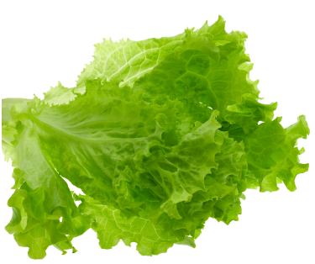
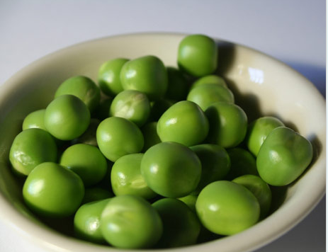
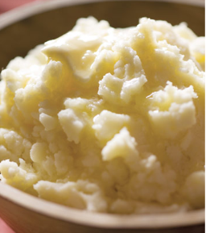
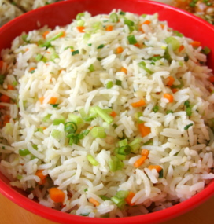
Grammar Chants

Slide 25
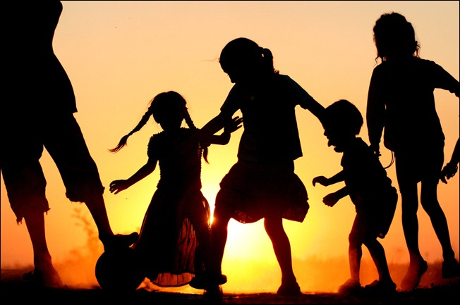
3. Games
http://ktf2012.weebly.com/language-games.html
Notes:
The purpose of playing games is to practice drilling as well as encourage some automatic response, natural language in an exciting, often competitive, atmosphere so that the children are motivated and concentrating on the game itself rather than stressing about the rules.
The most mundane of practice tasks can become enjoyable when presented in a game, with or without a physical reward for “winning’. These games are best played in teams to encourage team spirit and cooperation. An element of chance takes away the sting of losing and makes it possible for even the less able students to win and feel like winners.
When devising your own games, try to include these elements.
Here is a list of some types of language games that are worth a try:
Some Types of Language Games
There are many types of language games, all of which are adaptable to many situations. (Some games can fit into several of these categories.) These include:

Slide 26
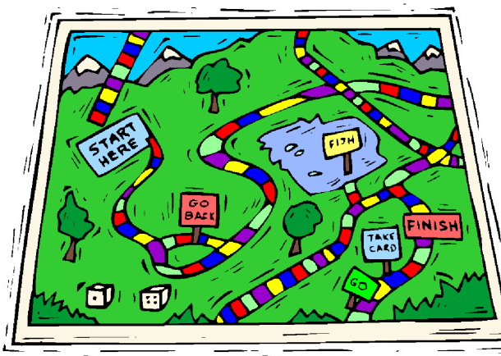
Types of Language Games
Board Games
Notes:
Board games: There are so many different board games available, you can easily make your own, and there are even templates available for making your own. A board game can be played with a partner, or in a group, or as a class with the ‘board’ drawn on the white/black-board.
Students need counters – they can draw their own characters on paper/card, or use buttons/shells/rocks/whatever – or you can use magnetic buttons or ‘tack’ a piece of cardboard on the board, or just draw the counters as they move.
There can be traps along the way – like the ‘snakes’ in ‘Snakes and Ladders’ – and rewards – like the ‘ladders’ – along the way.
It’s good if there is a language task each time they move along – they have to say something when they land on a square – with possibly a penalty (don’t move/move back) if they fail.
You need some kind of randomizer – a dice, or one/two coins, or some other clever method.

Slide 27
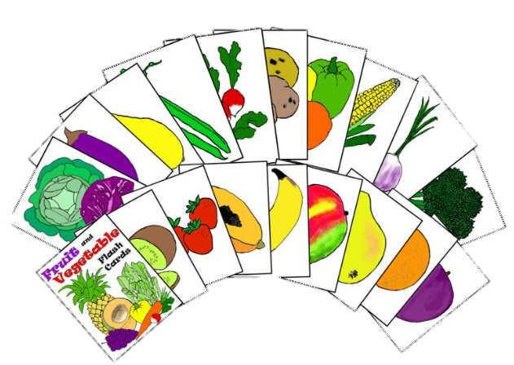
Types of Language Games
Card Games
Notes:
Card games: This can involve using
Playing Cards as a randomizer (each number has a meaning, requires a particular response),
specially designed Language Cards (a word or sentence or letter on each) for games designed like ‘Snap’ (turn over cards one at a time and say ‘snap’ when you see two the same, or two that match in some way), or ‘Happy Families’ (players try to collect sets of cards).
Regular classroom Flash Cards with a word / sentence / letter on each. As a whole class activity – besides holding them up and asking the class to call out the answer –it can become a competitive or cooperative game. Individual/pairs/groups/teams of students can be asked to match the card(s), put them in a particular order, find the correct card from a display or heap, throw the card into a hoop or bin, guess what is on the card, draw or describe a picture for another to draw … the list is endless. (The cards may need to be laminated to make them durable, or just accept that you need to keep making more – especially as once the game is played many of the words will be ‘known’ and new ones will be needed anyway.)

Slide 28
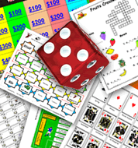
Types of Language Games
Dice Games
Notes:
Dice games: Obviously dice can be used for randomizing movements of counters in board games and the like, but they can be used for other specific language ideas as well.
Create a largish dice out of card, and write a question word (who, what, why, where, when, how) - or other prompt for a different aspect of learning - on each face. Students / pairs / groups / teams have to use the appropriate prompt after throwing the dice.
More than one dice can be used – maybe with a different letter on each, or a noun on one and adjective on another, or a word on one and an instruction on another.
You can get dice with a lot more than 6 sides, for instance one for each letter of the alphabet – if you get one of these, there are obvious games you can play.

Slide 29
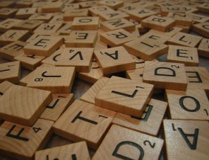
Types of Language Games
Word Making Games
Notes:
Word-Making Games: Commercial games such as ‘Scrabble’ and ‘Boggle’ can be played in the classroom in pairs/groups if you have enough sets. You could have several different games and groups rotate in different sessions. This type of game can also be played using cards with letters on (instead of the little tiles in something like Scrabble) and words can be formed on the floor or a desktop.
Whole class games at the black/white-board can also be devised along these lines with a pool of letters that they need to make into words, or making little words out of a big word.

Slide 30
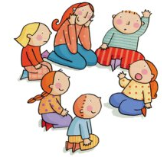
Types of Language Games
Circle Games
Notes:
Circle games are especially relevant for young children but can also be used with good results with older children (and even adults!) In the circle it is easier for the teacher to maintain control of the game, and develops cooperation and community feel among the participants. If the class is too big, or the space not suitable, the game can be played in 2 or more smaller groups, although this is harder to maintain control of, and loses some of the community feel.
The game can involve a song/chant which everyone joins in and then each participant in turn has to sing/say something.
The game can involve changing seat/position in response to certain prompts – this can for part of the reward/penalty. There can be one less seat than the number of participants.
There are many possibilities for cumulative circle games where one person makes a statement mentioning one object (such as “I went shopping and I bought … an egg”) and subsequent participants have to repeat all previous items and then add one of their own. The game is cooperative, and keeps going as long as the group can manage it.
Some examples of good circle games are “I like People Who …” (where participants who fit the description have to quickly change places, and the slowest one ends up standing and making the next statement) and “What are you doing?” (where participants each mime the action from the previous participant while naming a different action for the following participant to mime).
Games like “who stole the cookie” – where participants pat knees/clap/click a rhythm and pass turns by calling someone’s name – can be adapted to use other parts of language. Students can even each wear a word on a flashcard to be referred to and respond to.

Slide 31
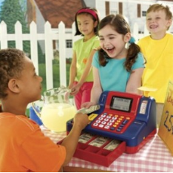
Types of Language Games
Role-Play Games
Notes:
Role play games are an obvious extension to conversational/speaking topics. These can be easily set up as a ‘line-up role-play’ where each student is part of a group which plays a particular role.
For example: In a shopping role-play some students are sellers and some are buyers. Sellers need to have a list/pictures/objects to sell, and buyers have money and shopping lists. It can become competitive as individuals/pairs/groups endeavour to buy/sell a certain amount first.
Other simple role-plays could include various community places/events such as doctor’s rooms, post office, travel agent, hotel lobby, library, marketplace, student services.

Slide 32
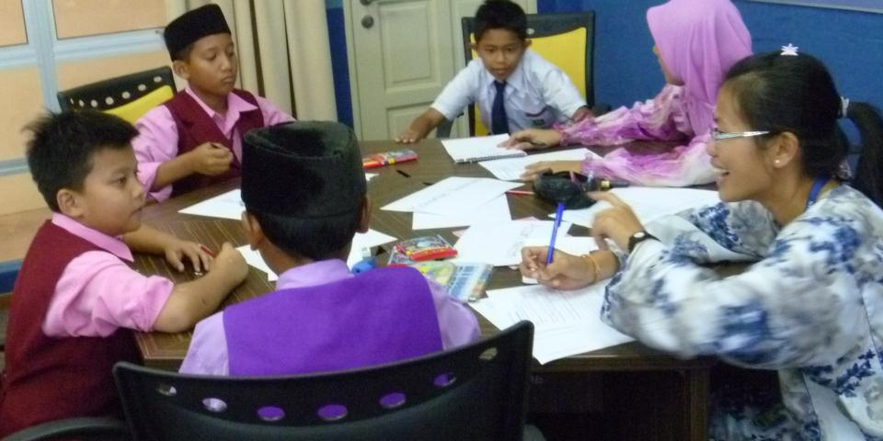
Types of Language Games
Discussion Games
Notes:
Discussion games can be another type of role-play.
For example: “Alibi”. In this game a student/pair/group are accused of a crime and have to get together to clarify their ‘story’ of exactly where they were and what they were doing at the time of the ‘crime’ including as many details as possible. Other class members in pairs/groups are the police who will separate and question each of the suspects who rotate around the groups, and see if their stories match.
Another discussion game can involve reading two texts (fiction or non-fiction). Half of the class reads one text and the other half reads the other. Then the papers are removed, and the students pair up with someone who read the other text. Each carefully tells their partner everything they can remember about their text. Then they swap to another partner who read the other text, and they are given a list of questions with which to test their new partner on what they have been told.

Slide 33
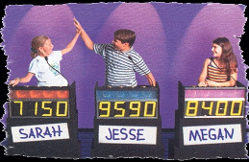
Types of Language Games
Quiz and Game Show
Notes:
‘Game Show’ and Quiz games can be a great whole class learning activity. Examples are
‘Typhoon’ (where each team has to answer a question and can then choose a box from the grid. The box may contain points, or an opportunity to ‘blow away’ someone else’s points),
‘Jeopardy’(modelled on the TV show of the same name),
‘Wheel of Fortune’ (from the TV show), or a similar ‘Hangman’.
All of these simply create a framework for winning points so that the students work together with their team and are motivated.
‘Celebrity Heads’ can also be played by the whole class with 2/3/4 … students at the front facing the class with a famous name worn (as a crown, maybe) around their heads so that they can’t see it (or it can be written carefully on the board behind them as long as they don’t turn round to look …) They take it in turns to ask questions of the class in order to discover who they are. (They must be yes/no questions, and a ‘yes’ response means they can then ask another before their turn ends).

Slide 34
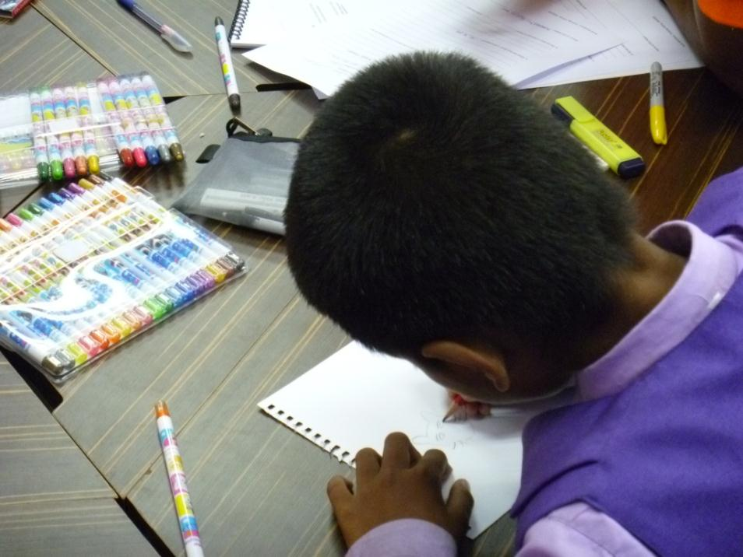
Types of Language Games
Drawing Games
Notes:
Drawing games: One well-known game is ‘Pictionary’ where one student/pair/team is shown a word/phrase/sentence and they have to draw something until the other student/pair/team guesses what it is. There are lots of ways to adapt this to learning objectives.
To give practice in describing, a simple picture or drawing can be pinned to the back of a chair so that a person at the white/black-board cannot see it but the class can. They then have to explain to the draw-er what to draw. There can be rules about who explains, or they can just call out. There can be two draw-ers, and it can be made into a competition.

Slide 35
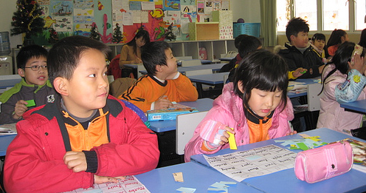
Types of Language Games
Games of Chance
Notes:
Games of Chance: Everybody loves ‘Bingo’, and this game can be adapted so many ways. There are programmes available on the Internet where you can enter (9/16/)25 words, and the programme will randomise the words so that every card contains the same words in a different order. Or you can add more than the required number, and then the students won’t be sure if the word is on their card or not. There are other ways to play, too, where the caller does not read the words that are on the cards, but a clue or question for which the answers are in the grid on the cards. Students will need some form of counters to use as bingo markers (sunflower seeds work well – but you have to decide whether the students are allowed to eat them), rather than marking the cards, so that they can play the game several times over.

Slide 36
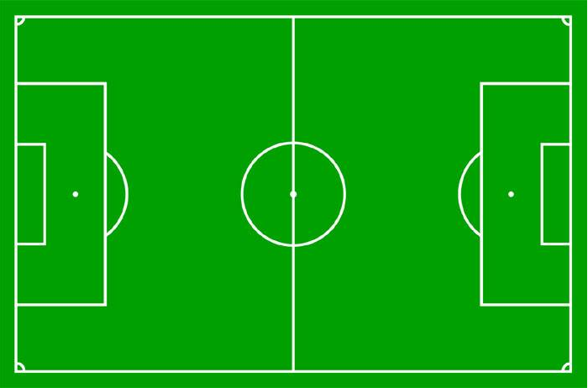







Reported Speech Soccer
Let’s Play!

Slide 37
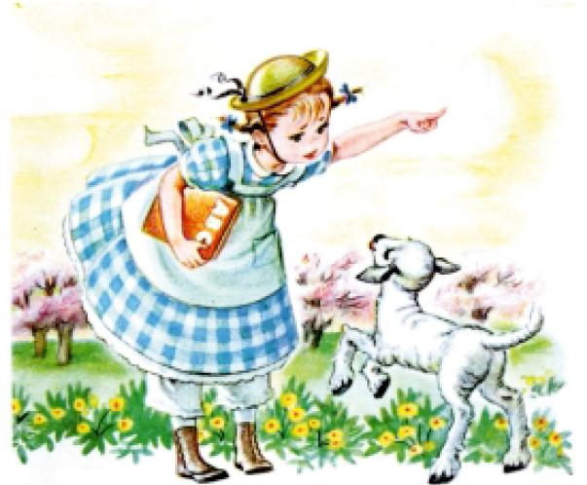
4. Nursery Rhymes and Poems
Notes:
Nursery Rhymes are essentially very old poems that have become traditional and lasted the test of years mostly because of their rhythmic quality. Some of them have tunes and have become traditional songs for children, and some of them are traditionally chanted. As with the traditional songs we looked at already, the rhythms, tunes and words are simple and easily adapted to suit our Grammar needs for the purpose of
Having fun, motivating students
Practising natural rhythmic language
Providing a structure for practising Grammar rules (in order to pass exams!)
Activity
Choose one of the Nursery Rhymes listed below.
Explain to your partner what Grammar it demonstrates and how you could use it.

Slide 38
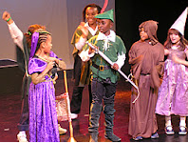
5. Plays and Dialogues
Notes:
Plays do not have to be a major production involving costume, stage and props. Children generally love acting or playing a part. Any story can be dramatized, giving opportunities for children to repeat sections of natural dialogue which demonstrates a particular point. Plays can be easily created from the stories we looked at earlier, and the dialogues changed and adapted to bring out a particular point. Children can be asked to write or adapt their own part.
Very short dialogues and role plays are easy to develop involving everyday situations and appropriate language. Children can have fun with minimal added wardrobe such as a hat or a name-tag to put them in the role.

Slide 39

A scene from a movie
Notes:
The dialogue could be taken out of a movie, or the stimulus could be a picture or cartoon or just an object.
In the movie “Finding Nemo”, there are many examples of Imperatives being used, such as when young Nemo goes out to touch the boat.
Students could watch the video segment, practise with it, perform without it, and make changes as well.

Slide 40
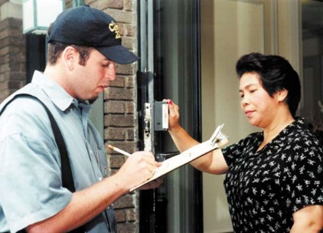
What is the dialogue?
Notes:
What is this conversation?
Any day-to-day situation such as shopping or eating in a restaurant can become a play.

Slide 41
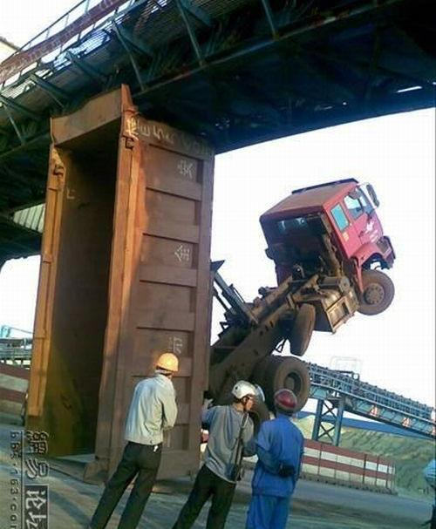
Create a Dialogue
Notes:
Activity
Create a dialogue from this picture. Use the Grammar points in the worksheet.
Look at the picture. What might each of the three men be saying?

Slide 42
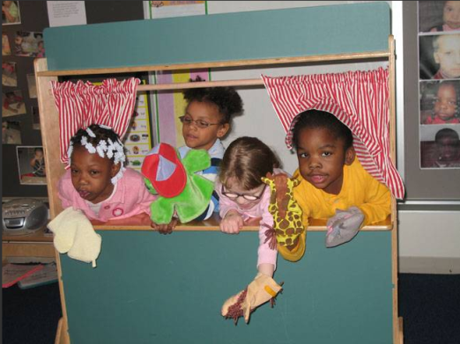
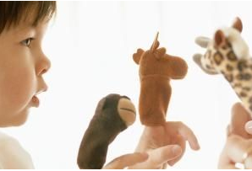
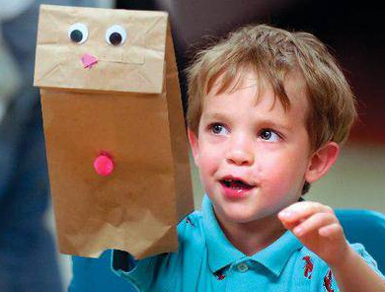
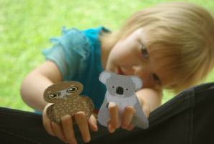
6. Puppets
Notes:
Puppets are an even more fun way of doing drama. Children who are maybe a little bit shy are often willing to do funny voices and everything when it is the puppet talking.
And then there is all the fun of designing and creating the puppets.

Slide 43
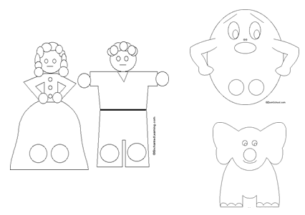
Project

Slide 44
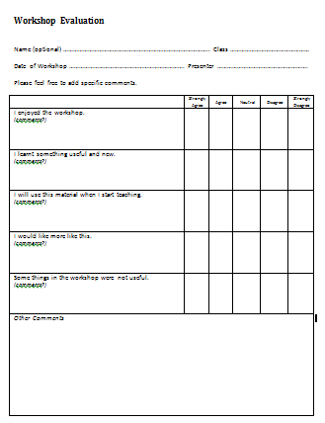
Please … Fill out the evaluation on the last page and hand it in.

