Slide 1
Preparing for Pop-Up Books
Start simple:
Making a Pop-Up
Card
Notes:
Little Books become especially interesting and exciting when they are pop-up books. However explaining the process simply can be daunting. This session provides a halfway stage to help students to understand the pop-up process.

Slide 2
You need:
pens/pencils
scissors
A4 or A3 paper
Notes:
As for the Little Books, all participants need a workspace (table or desk), writing materials, scissors, and a piece of paper.

Slide 3
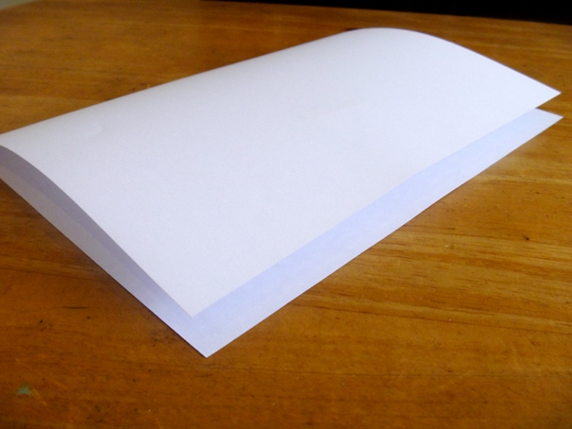
Step 1:
Fold the paper in half
Notes:
Firstly, fold the paper neatly in half. Crease the fold.

Slide 4
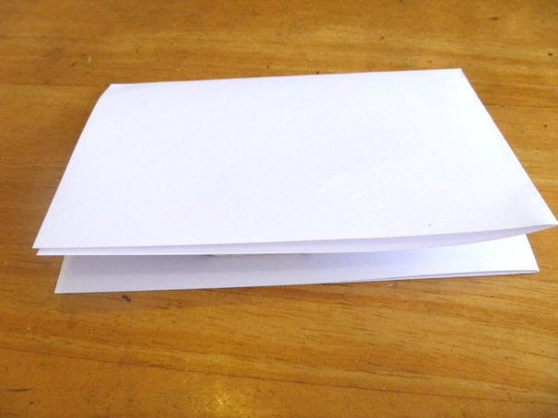
Step 2:
Fold the paper in half again
Notes:
Fold the paper a second time to create a greeting card, and crease the fold carefully.

Slide 5
Open the paper, and re-fold the other way.
Inside of Card
Notes:
The valley fold in the inside of the card is where the pop-ups will be created. The paper needs to be unfolded, and then the inside fold should be re-folded the other way in preparation for cutting.

Slide 6
For a beak or mouth:
cut
fold
Notes:
The simplest pop-up is a mouth or beak.
Demonstrate this to participants, but they should not make the cut until they have chosen which the pop-up they wish to create.
Make a single perpendicular cut into the fold that is the inside middle of the card. Fold both sides of the fold back and forth to both sides of the cut to create strong creases.

Slide 7
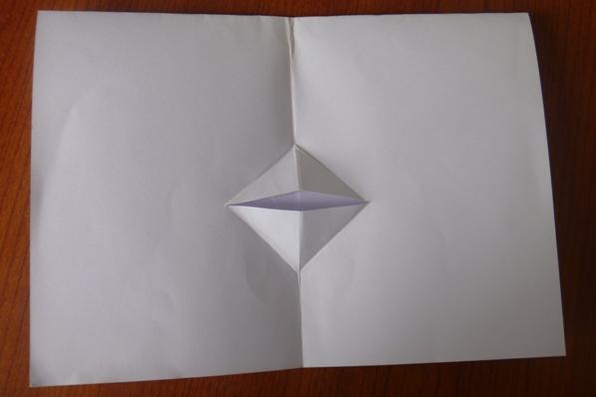
Re-fold card.
Put finger inside card to push out pop-up section.
Notes:
Fold the paper back the other way so that the cut is inside the card. You may need to put your finger inside the card to push out the pop-up section.

Slide 8
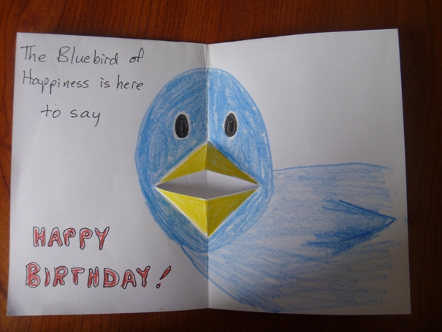
Decorate!
Notes:
Drawing, colour, and text complete the effect.
The mouth can be a human mouth, bird’s beak, or animal mouth – it depends only on the creator’s creativity.

Slide 9
Other Shapes:
Box Shape
Notes:
Demonstrate another possible pop-up shape.
Two perpendicular cuts can be used to create a box shape. The cuts should never go more than halfway across the card as this would cause the pup-up to protrude past the edge of the card when it is closed.

Slide 10
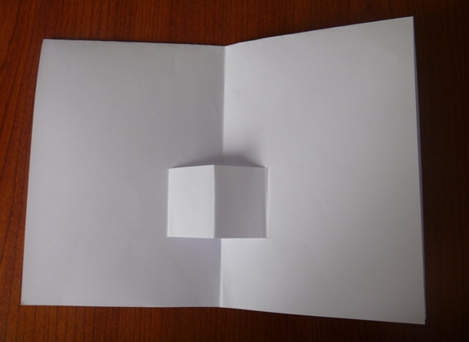
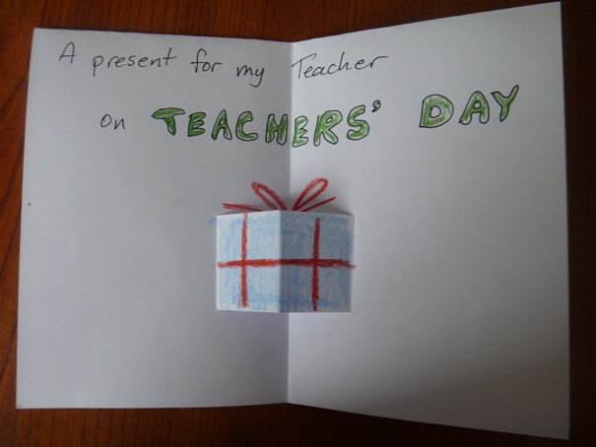
Make into a box, house, furniture ...
Notes:
This pop-up can be decorated as a box or a gift.
If the card is turned to ‘landscape’ format this can be something like a step, or a building.

Slide 11
A Face:
mouth
nose
Notes:
Two perpendicular cuts can be used for a pop-up nose and mouth in a face. The mouth cut is folded back on both sides to create the lips, and the nose cut is folded back to one side as a single triangle. Varying the length of the cuts ad the angles of the folds will change the character of the face.

Slide 12
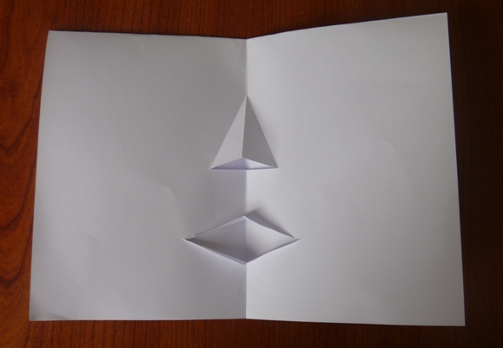
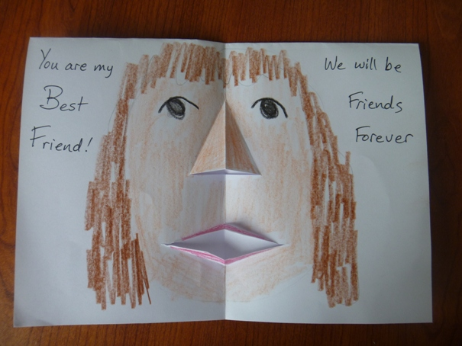
Decorate the face, create a character
Notes:
Decorating the card completes the effect.

Slide 13
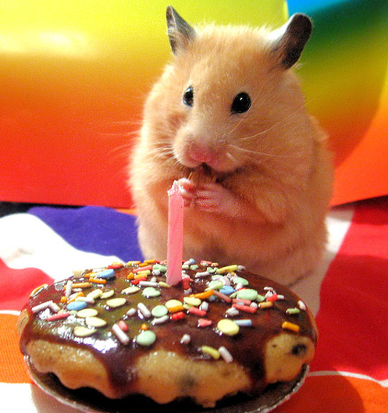
There are many occasions that could be celebrated with a card.
Notes:
Before practising with their pop-up cards, participants need to think about the occasion the card would be created for and what shape of pop-up would be appropriate and feasible.

