Slide 1
Using Traditional Songs and Rhymes
to teach English
By Ruth Wickham, Brighton Education Training Fellow, IPGKDRI

Slide 2
SONGS for
LITTLE KIDS
But you can use them to teach older children, or teenagers, IF you treat them in a light-hearted fashion, and/or adapt them by changing the words and/or the rhythms.

Slide 3
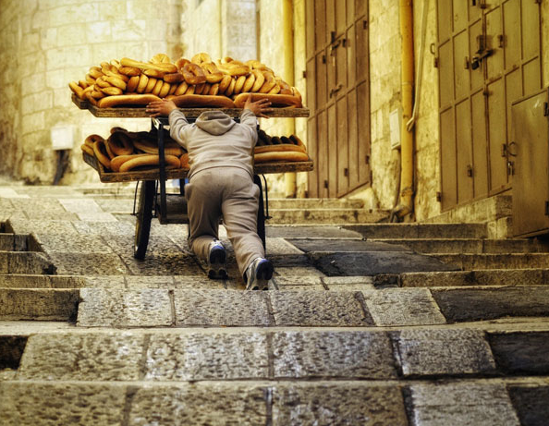
So ... today ...
Hopefully you will carry away lots of examples and ideas.

Slide 4

What is special about children’s music?
Children’s music often uses
Pentatonic Scale – 5 notes:
Normal Scale – 7 notes:
e.g. F major scale
Can be played on black keys

Slide 5
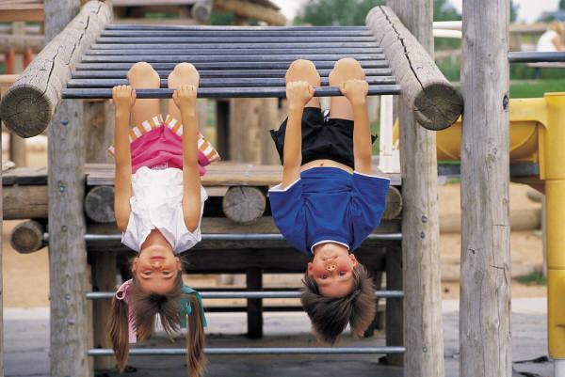
The Playground Tune
Nah!
Naah!
Naaah!
Naah!
Naaaah!
It’s a great little tune to put other words to.

Slide 6
It’s raining, it’s pouring ...
[tune: the playground tune]
It’s raining, it’s pouring
The old man is snoring
He went to bed
And bumped his head
And couldn’t get up
In the morning

Slide 7
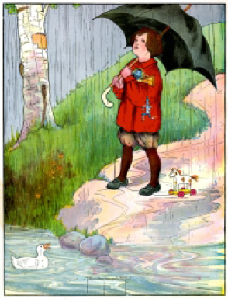
Rain, rain go away
Rain, rain, go away,
Come again another day,
Little Johnny wants to play.
Rain, rain, go to Spain,
Never show your face again.
Rhymes with tunes

Slide 8
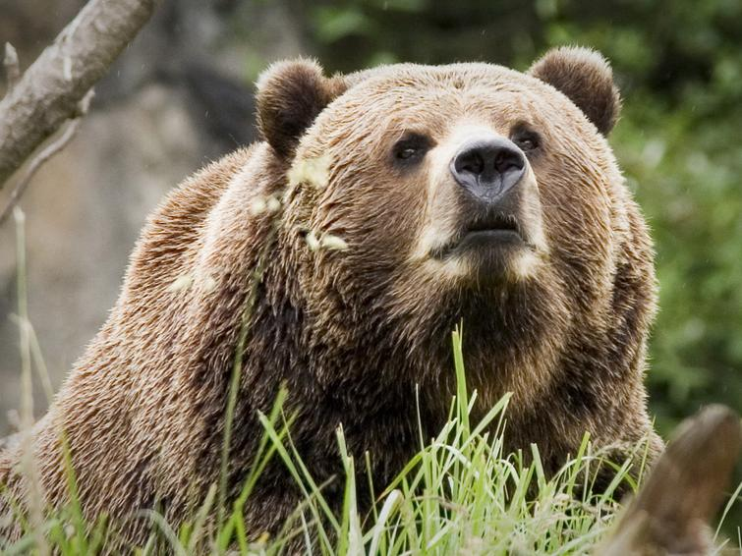
Echo song:
I met a bear

Slide 9
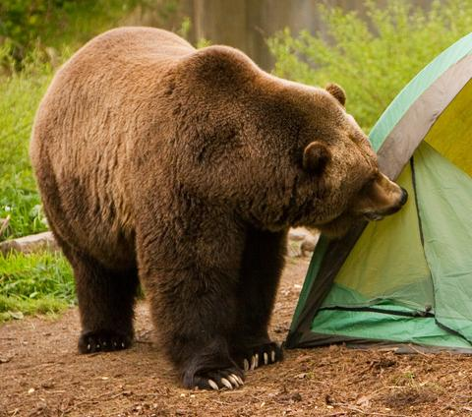
Leader, then echo, then unison ...
Leader: Group, echoing:
The other day (The other day)
I met a bear (I met a bear)
A way up there (A way up there)
A great big bear (A great big bear)
Everyone:
The other day I met a bear
A great big bear a way up there
[Continue this pattern throughout the song.]
He looked at me
I looked at him
He sized up me
I sized up him
He said to me
Why don't you run
I see you don’t
Have any gun

Slide 10
I met a bear (cont ...)
[I said to him
That's a good idea
So come on feet
Let's get out of here]
And so I ran
Away from there
And right behind
Me was that bear
Ahead of me
I saw a tree
A great big tree
Oh, Golly Gee!
The lowest branch
Was ten feet up
I had to jump
And trust my luck
And so I jumped
Into the air
And missed that branch
A way up there
Now don't you fret
And don't you frown
I caught that branch
On the way back down
That's all there is
There is no more
Until I meet
That bear once more
The end, the end, The end, the end
The end, the end, The end, the end
... This time it really is the end.

Slide 11
Syllable and stress pattern:
The oth- -er day
I met a bear
A great big bear
A way up there

Slide 12
Can you put words to the pattern?

Slide 13
Can you put words to the pattern?
My fav’ - rite food
Is fish and rice
When my mum cooks
It tastes so nice.

Slide 14
Another
Version
The littlest worm I ever saw
Got stuck inside My soda straw
He said to me Don't take a sip
For if you do I'll surely slip
I took a sip And he went down
All through my pipes He must have drowned
He was my pal He was my friend
And now he's gone And that's the end
The moral of (Repeat) This little tale (Repeat)
Is If you see a worm (Repeat) Just don't inhale (Repeat)
(Repeat everything shouting:) Just Don't Inhale!

Slide 15
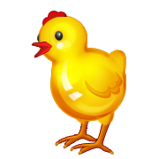

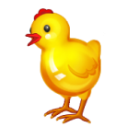
Well-known, easy tune, lots of possibilities for variation ...
Old MacDonald
Old MacDonald had a farm, E I E I O,
And on his farm he had some chicks, E I E I O.
With a chick chick here and a chick chick there,
Here a chick, there a chick, ev'rywhere a chick chick.
Old MacDonald had a farm, E I E I O.
Old MacDonald had a farm, E I E I O,
And on his farm he had a cow, E I E I O.
With a moo moo here and a moo moo there,
Here a moo, there a moo, ev'rywhere a moo moo.
Old MacDonald had a farm, E I E I O.
...

Slide 16
Well-known, easy tune, lots of possibilities for variation ...
Old MacDonald
Create songs for vocabulary practice within a theme:
In the shop they have some ...
drinks / toys / books / ...
In the street I saw a ...
bus / car / truck ...
On my desk I have some ...

Slide 17
Variation – practice adjective opposites etc
Old MacDonald had a farm E-I-E-I-O
And on that farm he had some cows E-I-E-I-O
Fat cow, thin cow, thin cow, fat cow.
Old MacDonald had a farm E-I-E-I-O
Old MacDonald had a farm E-I-E-I-O
And on that farm he had some sheep E-I-E-I-O
Tall sheep, short sheep, short sheep, tall sheep.
Fat cow, thin cow, thin cow, fat cow.
Old MacDonald had a farm E-I-E-I-O
Old MacDonald had a farm E-I-E-I-O
And on that farm he had some ducks E-I-E-I-O
Big ducks, small ducks, small ducks, big ducks,
Tall sheep, short sheep, short sheep, tall sheep,
Fat cow, thin cow, thin cow, fat cow.
Old MacDonald had a farm E-I-E-I-O
And lots more possibilities such as:
...he had some cats
E-I-E-I-O
Sleepy cats, scary cats, scary cats, sleepy cats ...

Slide 18
Getting the Beat right
Marching Beat: 1.2.1.2
Waltz Beat: 1.2.3.1.2.3
Rock Beat: 1.2.3.4.1.2.3.4
Compound Time: 1.2.3.4.5.6.1.2.3.4.5.6
Notes:
The waltz beat is the only one that we need to be especially aware of. All the others can be marched to.

Slide 19

A Four-Beat Rhythm:
First beat is always the strongest.
A song often starts on the (weak) upbeat before the first beat.
We say ‘and’ to count the half beats,
(and) One (and) Two (and) Three (and) Four

Slide 20

In your Group – make some rhythm:
Instruments you could use:
Clap your hands
Stamp your feet
Use your mouth
Tap some chopsticks
Slap a book

Slide 21

Take a couple of minutes ...
...and work out a rhythm.

Slide 22
Clapping games
A clapping pattern could be:
Pat, Pat, Clap, Clap
Right hand, clap,
Left hand, clap

Slide 23
Take a couple of minutes ...
...and try one with a partner.

Slide 24
A Waltz Rhythm
Stamp
Clap
Clap
1
2
3
This rhythm has a very different feel.

Slide 25
Two part song, very long, repetitive ...
Boys: There’s a hole in my bucket, dear Liza, dear Liza.
There’s a hole in my bucket, dear Liza, a hole.
Girls: Then fix it, dear Henry, dear Henry, dear Henry.
Then fix it, dear Henry, dear Henry, fix it.
Boys: With what shall I fix it, dear Liza, dear Liza?
With what shall I fix it, dear Liza, dear Liza?
Girls: With a straw, dear Henry, dear Henry, dear Henry.
With a straw, dear Henry, dear Henry, a straw.
  Boys: But the straw is too long, dear Liza, dear Liza, dear Liza.
But the straw is too long, dear Liza, too long.
[This song is in Waltz time]
Continued ...

Slide 26
With a twist ... making it a circular song.
Girls: Then cut it, dear Henry, dear Henry, ...
Boys: With what shall I cut it, dear Liza, ...
Girls: With an axe, dear Henry, ...
Boys: But the axe is too blunt, dear Liza, ...
Girls: Then sharpen it, dear Henry, ...
Boys: With what shall I sharpen it, dear Liza, ...
Girls: With a stone, dear Henry, ...
Boys: But the stone is too dry, dear Liza, ...
Girls: Then wet it, dear Henry, ...
Boys: With what shall I wet it dear Liza,...
Girls: With water, dear Henry, ...
Boys: In what shall I fetch it, dear Liza, ...
Girls: In a bucket, dear Henry, ....
Boys: But there’s a HOLE in my bucket, dear Liza, dear Liza!
There’s a hole in my bucket, dear Liza, dear Liza, a hole!

Slide 27


A cumulative song:
I knew an old lady who swallowed a fly
I don't know why she swallowed the fly
Perhaps she'll die
I knew an old lady who swallowed a spider
That wiggled and jiggled and tickled inside her
She swallowed a spider to catch the Fly
I don't know why she swallowed the fly
Perhaps she'll die
...
How absurd, to swallow a bird!
She swallowed a bird to catch the spider ...
[This song is in compound time]
Continued ...

Slide 28
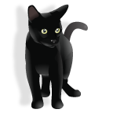
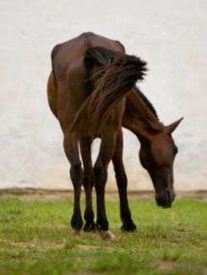
... Imagine that, she swallowed a cat! ...
... What a hog, to swallow a dog! ...
... She opened her throat and swallowed the goat! ...
... I don't know how she swallowed the cow! ...
I knew an old lady who swallowed a horse.
She's dead of course!

Slide 29
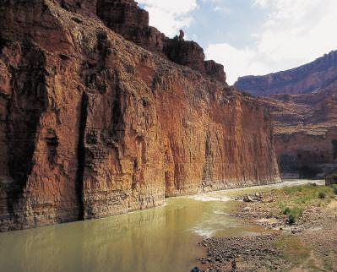
In a cavern, in a canyon
Excavating for a mine
Lived a miner forty-niner
And his daughter, Clementine
Chorus:
Oh, my darling, oh, my darling
Oh, my darling Clementine
You are lost and gone forever
Dreadful sorry, Clementine
Light she was and like a fairy
And her shoes were number nine
Herring boxes without topses
Sandals were for Clementine
(chorus)
Drove her ducklings to the water
Every morning just at nine
Hit her foot against a splinter
Fell into the foaming brine
(chorus)
Clementine
A tune to use for many things
Ruby lips above the water
Blowing bubbles soft and fine
But, alas, I was no swimmer
So I lost my Clementine
(chorus)
How I missed her, how I missed her
How I missed my Clementine
Till I kissed her little sister
And forgot my Clementine
Oh, my darling, oh, my darling
Oh, my darling Clementine
You are lost and gone forever
Dreadful sorry, Clementine
[This song is in waltz time]

Slide 30

Using Clementine for circle time
What‘s the weather
What's the weather
What's the weather like today?
Tell us (name), what's the weather?
What's the weather like today?
Is it sunny (make big circle with arms above head)
Is it cloudy (cover eyes with hands)
Is it rainy out today (rain fingers)
Is it snowy (act cold)
Is it windy (windy arms)
What's the weather like today?

Slide 31
Circular song: - Found a Peanut
Found a peanut, found a peanut,
Found a peanut just now,
Just now I found a peanut,
Found a peanut just now.
Cracked it open, cracked it open, ...
It was rotten, it was rotten, ...
Ate it anyway, ate it anyway, ...
Got a stomach ache, got a stomach ache, ...
Called the doctor, called the doctor, ...
Penicillin, Penicillin, ...
Operation, operation, ...
Died anyway, died anyway, ...
Went to heaven, went to heaven, ...
Wouldn't take me, wouldn't take me, ...
Went the other way, went the other way, ...
Didn't want me, didn't want me, ...
Was a dream, was a dream, ...
Then I woke up, then I woke up, ...
Found a peanut, found a peanut, ...
Tune: Clementine

Slide 32
Another
Circular
Song
There's a spider on the floor, on the floor.
There's a spider on the floor, on the floor.
Who could ask for anything more, than a spider on the floor.
There's a spider on the floor, on the floor.
Now the spider's on my leg, on my leg. ...
Oh, I wish I had some Raid for this spider on my leg! ...
Now the spider's on my chest, on my chest! ...
Oh, I'd squish him in my vest, if it didn't make a mess! ...
Now the spider's on my neck, on my neck! ...
Oh, I'm gonna be a wreck, I've got a spider on my neck! ...
Now the spider's on my face, on my face! ...
Oh, what a big disgrace, I've got a spider on my face! ...
Now the spider's on my head, on my head! ...
Oh, I wish that he were dead. I've got a spider on my head! ...
SPOKEN: "But he jumped off.... “ [start back at the beginning]
Tune: if you’re happy and you know it

Slide 33
Frog went a courtin' and he did ride, uh-huh
Frog went a courtin' and he did ride
With a sword and a pistol by his side, uh-huh uh-huh.
He rode right up to Miss Mousie's door, uh-huh ... (repeat)
Gave three loud raps, and a very big roar, uh-huh uh-huh.
He said, "Miss Mouse, will you marry me? uh-huh ...
And oh so happy we will be, uh-huh uh-huh.
"Not without Uncle Rat's consent", uh-huh ...
"Would I marry the President," uh-huh uh-huh.
Uncle Rat, he went downtown, uh-huh ...
To buy his niece a wedding gown, uh-huh uh-huh.
Where shall the wedding supper be? uh-huh...
Way down yonder in the hollow tree, uh-huh uh-huh.
The first to come in was a bumble bee, uh-huh ...
With a big bass fiddle on his knee, uh-huh uh-huh.
Next to come in was the big black snake, uh-huh ...
He gobbled down the wedding cake, uh-huh uh-huh.
Little bit of biscuit on the shelf, uh-huh ...
If you want anymore you can sing it yourself, uh-huh uh-huh.
Story Song …
[Rock beat music]

Slide 34
A tune for many occasions:
Twinkle Twinkle Little Star
Twinkle, twinkle, little star.
How I wonder what you are!
Up above the world so high
Like a diamond in the sky.
Twinkle, twinkle, little star.
How I wonder what you are!
[March beat]

Slide 35
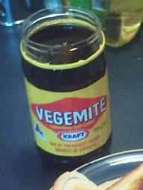
Australian Style
Twinkle
Twinkle, Twinkle Vegemite,
on a sandwich brown or white, Spread it thick on buttered toast.
That's the way I like it most.
Twinkle, Twinkle vegemite,
I'm okay and you're alright

Slide 36
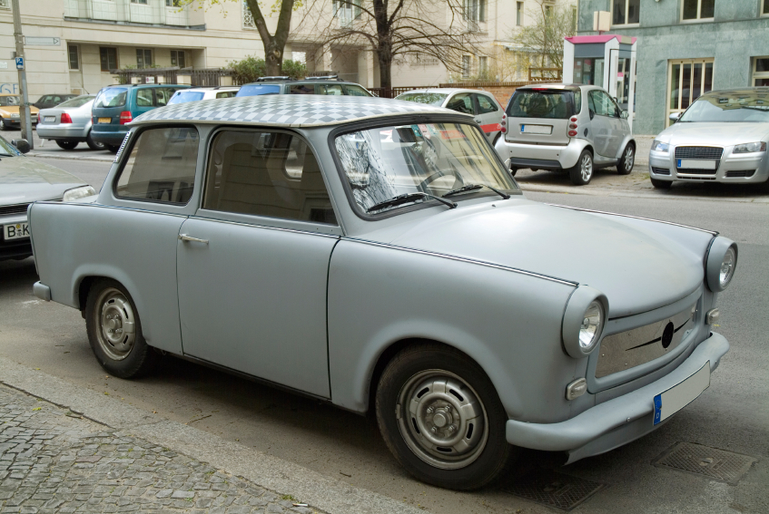
Another Twinkle
Twinkle, Twinkle Little Star
Daddy bought a motor car.
Push the button, pull the choke.
Off We go in a cloud of smoke.
Twinkle, Twinkle Little Star.
Daddy bought a motor car.

Slide 37
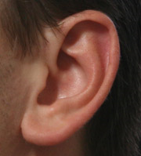
Do Your Ears Hang Low?
Do your ears hang low?
Do they wobble to and fro?
Can you tie them in a knot?
Can you tie them in a bow?
Can you throw them over your shoulder
like a continental soldier?
Do your ears hang low?
Do your ears hang high?
Do they reach up to the sky?
Do they droop when they're wet?
Do they stiffen when they're dry?
Can you semaphore your neighbour
with a minimum of labour?
Do your ears hang high?
Do your ears hang wide?
Do they flap from side to side?
Do they wave in the breeze
From the slightest little sneeze?
Can you soar above the nation
with a feeling of elation?
Do your ears hang wide?
Do your ears fall off?
When you give a great big cough?
Do they lie there on the ground?
Or bounce up at every sound?
Can you stick them in your pocket
just like little Davy Crockett?
Do your ears fall off?

Slide 38
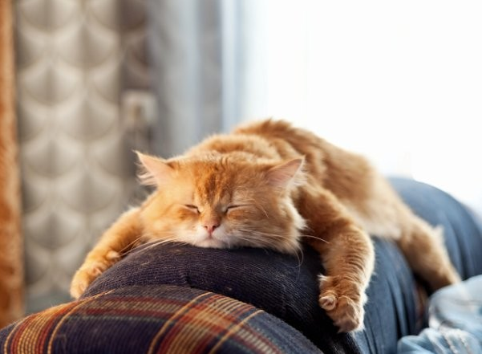
Rheumatism, Rheumatism,
How it pains, How it pains,
Up and down my system,
Up and down my system,
When it rains, When it rains.
Frère Jacques,
Frère Jacques,
Dormez vous?
Dormez vous?
Sonnez les matines,
Sonnez les matines,
Din, din, don!
Din, din, don!
Are you sleeping,
Are you sleeping?
Brother John?
Brother John?
Morning bells are ringing,
Morning bells are ringing,
Ding ding dong,
Ding ding dong.

Slide 39

She’ll be Coming Round the Mountain
She'll be comin' 'round the mountain when she comes. (Whoo, whoo!)
She'll be comin' 'round the mountain when she comes. (Whoo, whoo!)
She'll be comin' 'round the mountain, comin' 'round the mountain
She'll be comin' 'round the mountain when she comes. (Whoo, whoo!)
She'll be driving six white horses, when she comes (Whoa, back!)
. . .
She'll be driving six white horses, when she comes
(Whoa, back! Whoo, Whoo!)
Oh, we'll all go out to meet her when she comes (Hi babe!) . . .
She'll be wearing silk pajamas when she comes [Wolf whistle] . . .
And, we'll wear our bright red woolies when she comes [Scratch, scratch!] . . .
More verses ...
[Rock beat]

Slide 40
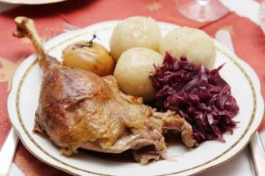
Oh, we'll kill the old red rooster,
when she comes (chop chop)
Oh, we'll all have chicken and dumplings when she comes
(Yum, yum! / Yuck, yuck!) . . .
Oh, we'll all have indigestion when she comes
(Burp, burp!) . . .
Oh, she'll have to sleep with Grandma when she comes (Snore, snore!) …
She'll have to sleep with Grandma when she comes (snore snore, burp burp, yum yum, hack hack, scratch scratch, [wolf whistle], Hi babe!, Whoa! Back!, Whoo Whoo!)

Slide 41

Contact:
Ruth Wickham: ruth.wickham@gmail.com
Website: http://songsandpoetryforesl.weebly.com

