Slide 1
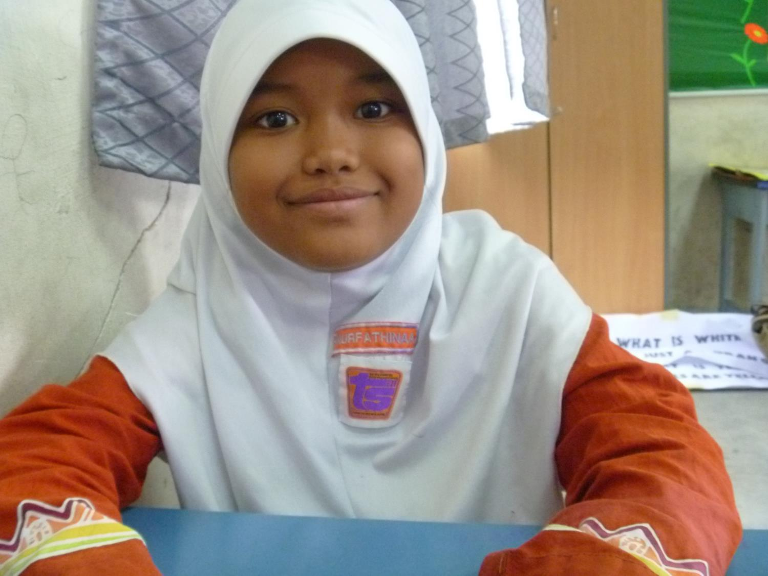
Games and Activities
Keeping Children Engaged in the Primary ESL Classroom

Slide 2
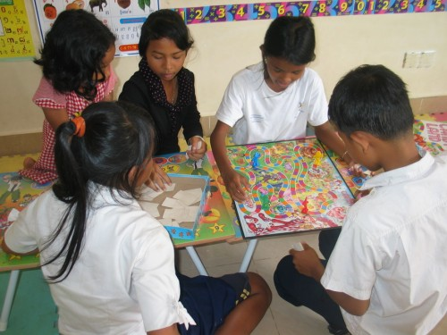
What are the elements of a good game or activity in the classroom?

Slide 3
1. Surprise!

Slide 4
1. Surprise!
Something random or unexpected, such as:
Grouping
Taking turns
Questions
Points scored
It is possible for anyone to succeed or win.

Slide 5
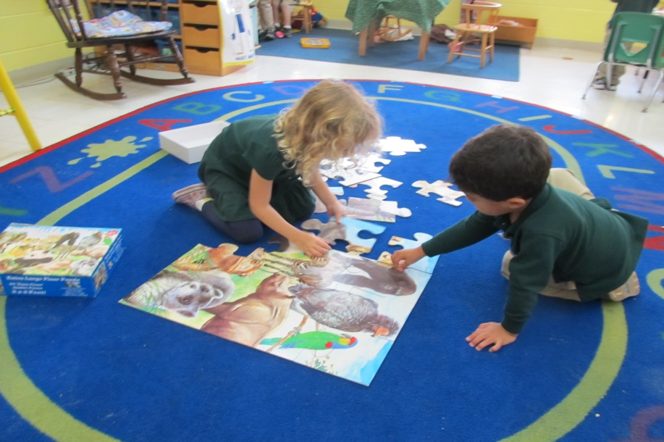
2. A Challenge

Slide 6
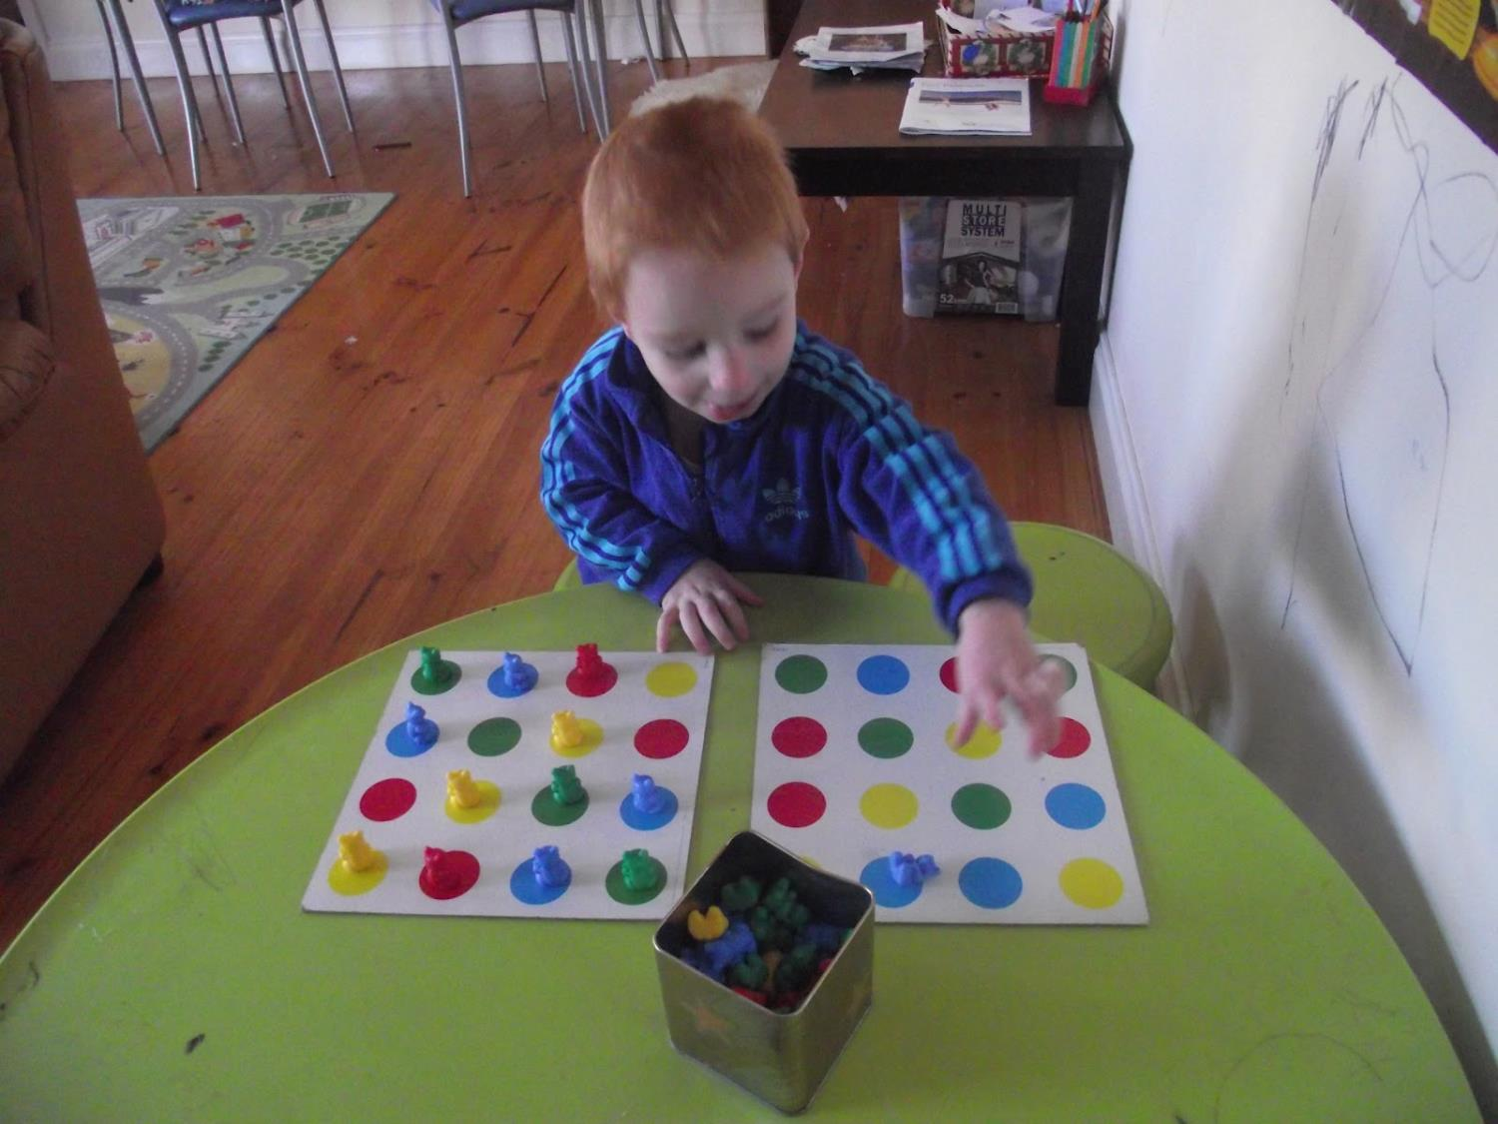
2. A Challenge
Children like to compete:
Against themselves
Against each other
As part of a team
Cooperatively
BUT Children should not be afraid of losing / failing.

Slide 7
3. A Reward

Slide 8
3. A Reward
Any kind of encouragement, such as:
Encouraging words
‘High Five’, or ‘fist bump’
Applause from classmates
Sweets, stickers, stationary, or toys
Points or marks on a chart
Privileges such as choosing the next participant
Different children are motivated by different rewards.

Slide 9
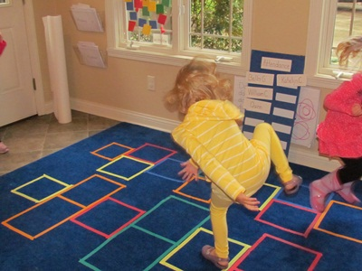
Designing and Creating your own activities
Materials for games and activities need to be:
Readily available
Economical
Adaptable
Cheap and disposable, OR durable and reusable
Game must be quick to prepare

Slide 10
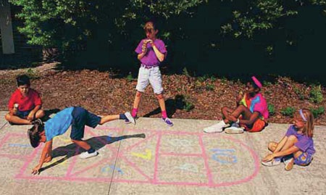
Keep it simple
Avoid
Complicated sets of rules
Complicated equipment
Complicated skills required

Slide 11
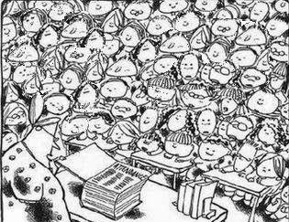
Everybody can play
Allow for pairs, groups or teams in large classes,
and make sure everyone gets a turn.

Slide 12
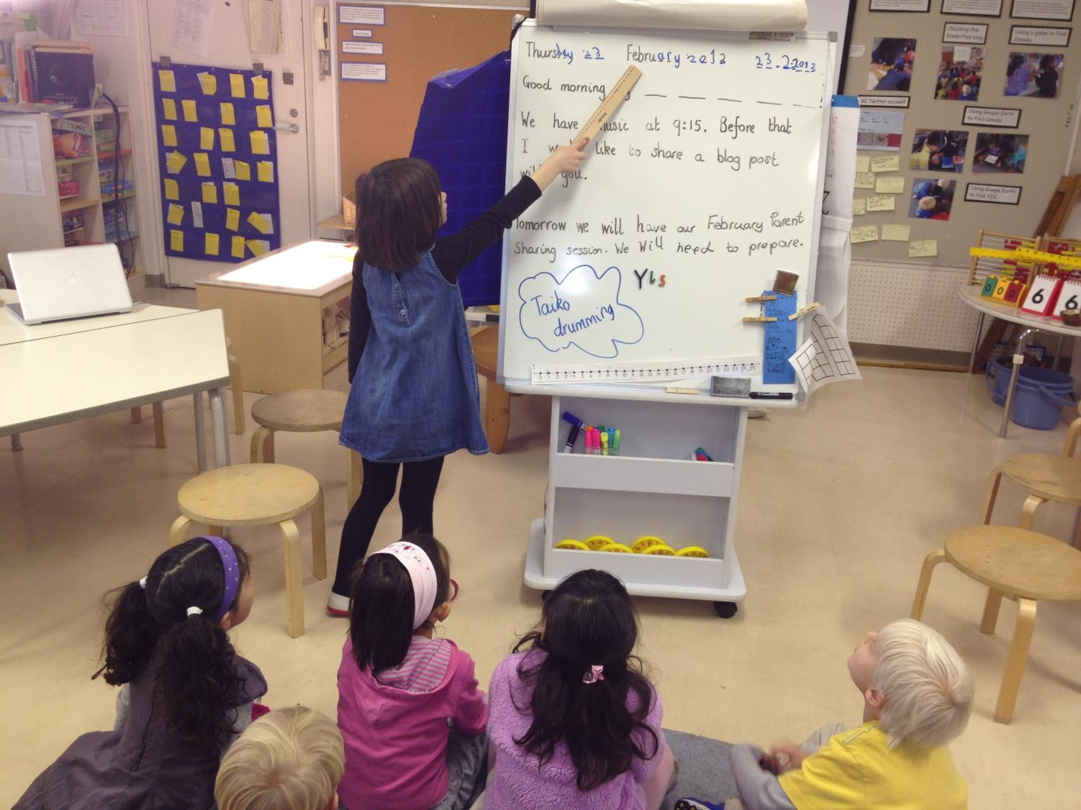
Children can run the game
... eventually

Slide 13
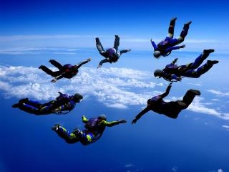
Some other things to try:

Slide 14
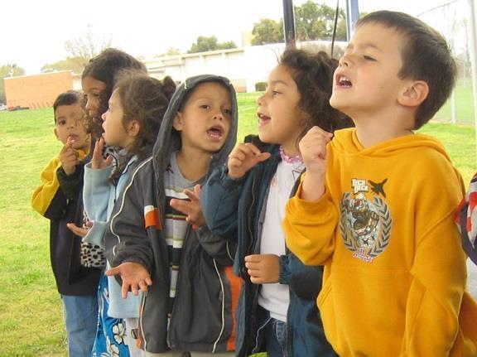
Sing, don’t shout
Recent brain research tells us that when children sing and move to music, their developing brains are entirely engaged and stimulated. Both the left and right sides of the brain are activated when we sing.

Slide 15
Sing, don’t shout
Sing it
Whisper it
Say it to a partner,
to the ceiling,
to the window
Say it without opening your lips
...

Slide 16
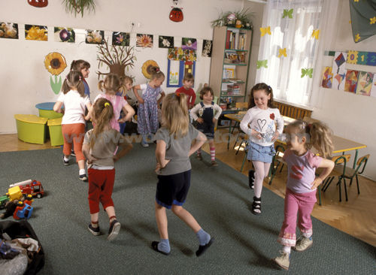
Rhythm and Movement
Find ways to build rhythm and movement into EVERYTHING.

Slide 17
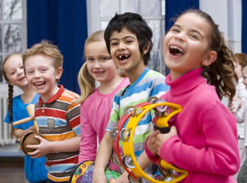
Keep their hands busy
Think of a movement or activity,
or something to hold/use in their hands.
(Otherwise they will find their own activity!)

Slide 18
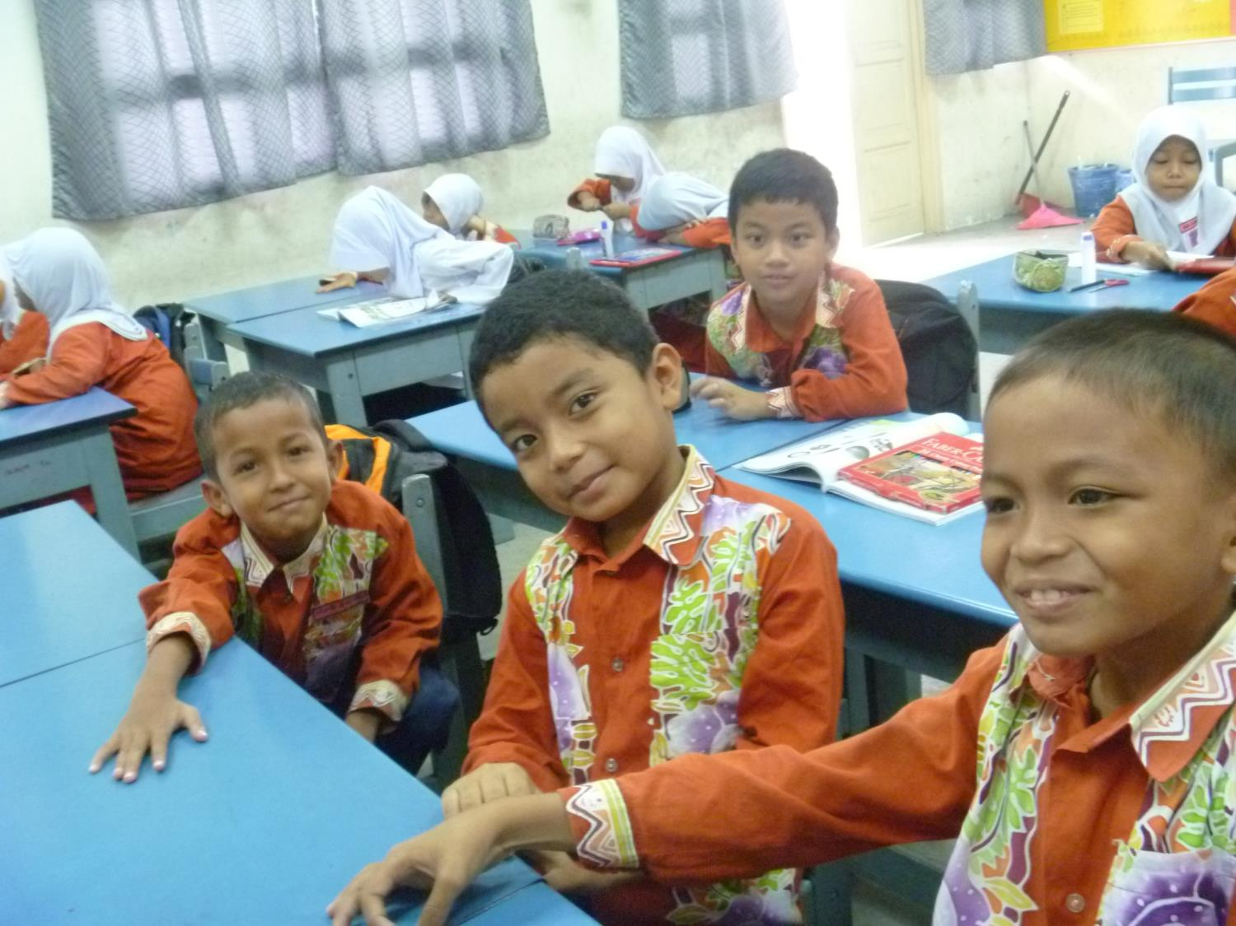
Let’s look at some specific ideas...

