Slide 1
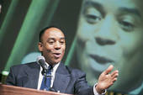
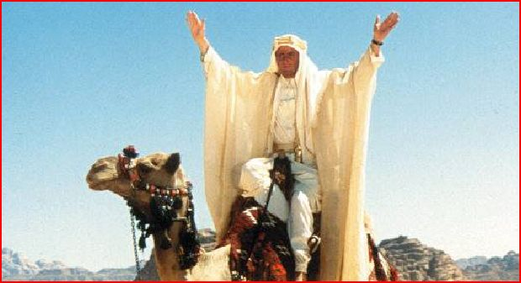
PUBLIC SPEAKING
the 5-10 minute talk

Slide 2
Kapas Island Workshop : April 9-11 April 2011
Sunday 10th April 10:45-12:45pm
Congratulations on your selection of public speaking topic Number 40:
“Square”
You will present a 5-10 minute talk on this topic, following the guidelines of preparation.

Slide 3
(My topic)
_______________________________

Slide 4
Not cool
Square meat
Right angles
2D Shapes
Set square
(My topic)
SQUARE
Square dance
Peg in a round hole
“qu” words
Rhymes with stare
Rare
fair
Square meal
Village square

Slide 5
Choose 5 of your most interesting sub-topics. Try to join them together in a logical sequence. List them here using only one word to remind you of each point:
a)
b)
c)
d)
e)
Not cool
2D
Peg
Meal
Dance

Slide 6
Choose 5 of your most interesting sub-topics. Try to join them together in a logical sequence. List them here using only one word to remind you of each point:
a)
b)
c)
d)
e)
Not cool
2D
Peg
Meal
Dance
90 seconds
90 seconds
90 seconds
90 seconds
90 seconds
----------------------------
7min 30 sec + 30 sec intro & exit = 8 mins
----------------------------

Slide 7
(My topic)
Malaysia’s best food

Slide 8
Choose 5 of your most interesting sub-topics. Try to join them together in a logical sequence. List them here using only one word to remind you of each point:
a)
b)
c)
d)
e)
Be prepared to speak on each sub-point for up to 30 seconds. Add one-word notes to your sub-points above.

