Slide 1
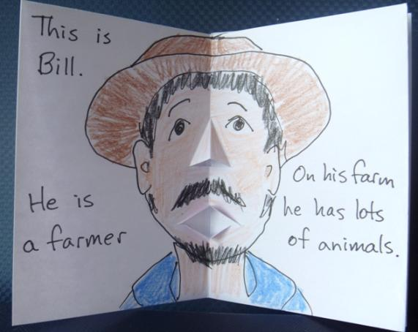
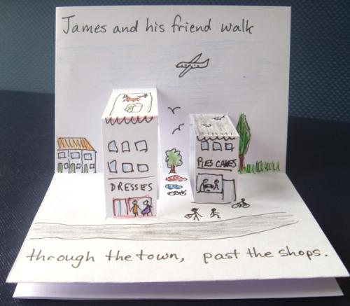
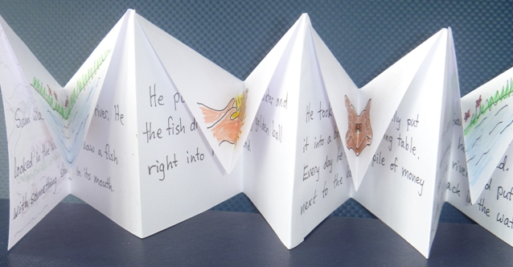
Pop-Up Books
Notes:
Making a pop-up little book adds wonder and surprise and delights young readers, as well as bringing the pleasure of creativity to its maker.
There does not need to be a pop-up on every single page, and even young children can be taught to insert at least one pop-up into their little books.

Slide 2
You need:
pens/pencils
scissors
A4 or A3 paper
Notes:
As with the basic Little Book, the required materials are a workspace (desk or table), paper, scissors, and drawing materials. For a pop-up book, better results will be achieved with better quality (thicker, stiffer) paper, but this is not essential.

Slide 3
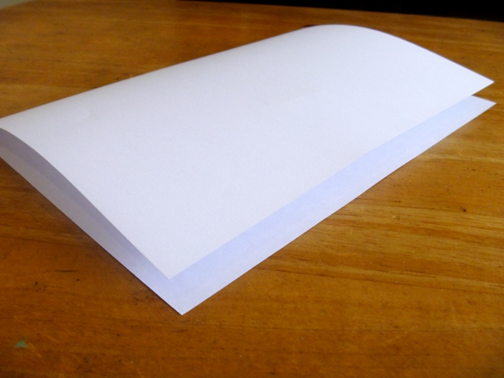
Step 1:
Fold the paper in half
Notes:
Go through the steps to create the basic little book. (The steps are repeated here.)
Firstly, fold the paper neatly in half, and crease the fold.

Slide 4
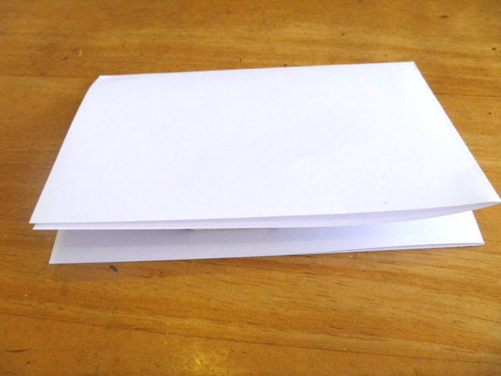
Step 2:
Fold the paper in half again
Notes:
Secondly, fold the paper again, being careful to make sure the edges line up neatly, and crease the fold well.

Slide 5
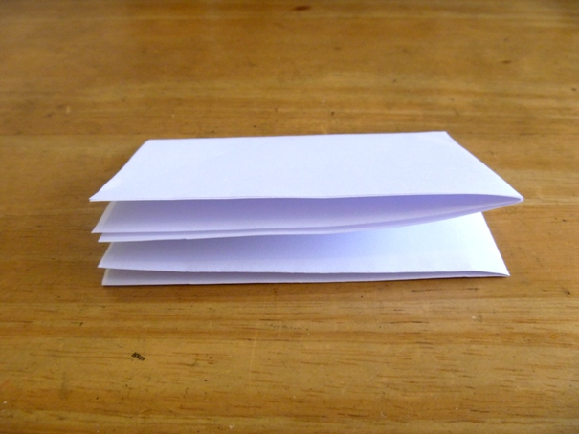
Step 3:
Fold the paper in half a third time
Notes:
Thirdly, fold the paper one more time. At this stage younger students may need assistance to make sure they can complete a neat fold.

Slide 6
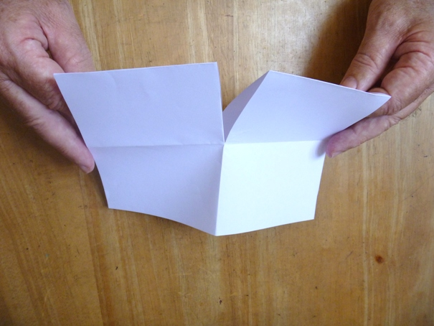
Step 4:
Unfold as far as the first fold
Cut down to the fold mark
from the fold edge
Notes:
Now, unfold back to the first fold.
Take the scissors and cut from the folded edge to the fold mark half way through. Again, young children will need extra supervision at this point.
As this is the only cut (unless you are making pop-up books), in a classroom situation a few pairs of scissors can be passed around and then removed.

Slide 7
Step 5:
Fold
Cut section
Unfold, and re-fold the other way
Notes:
Open the paper, and re-fold it the other way – keeping the same side of the paper on the outside. (Remember this can be done on re-cycled paper and the used side needs to stay inside.) If students open the paper and fold it outwards the other way then the next step will not work.
The paper is now folded longways, with the small cut section at the top as shown.

Slide 8
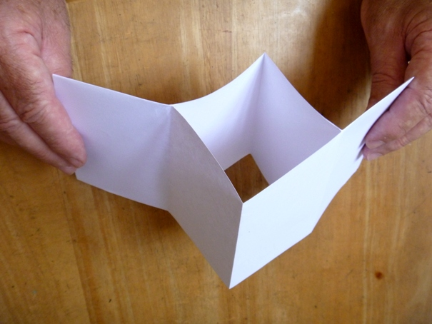
Hold the two ends ...
... and push them together.
Notes:
This is when the ‘magic’ happens. Hold the two ends and push them together as shown. The cut section will open a hole in the middle.

Slide 9
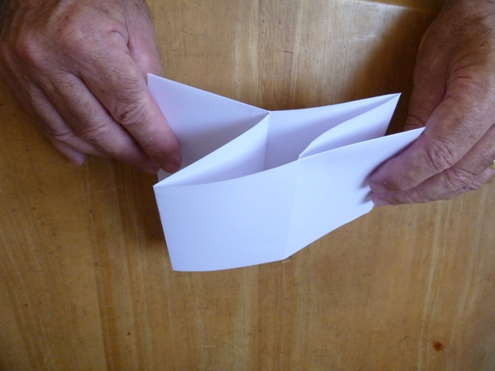
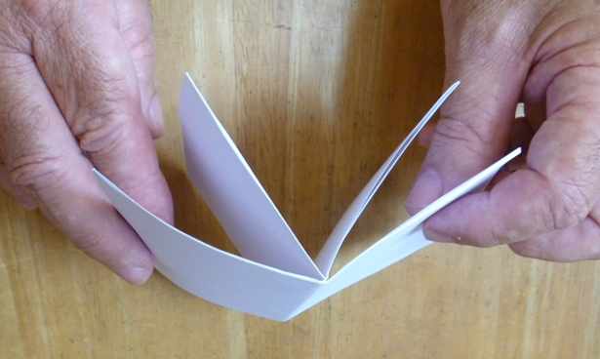
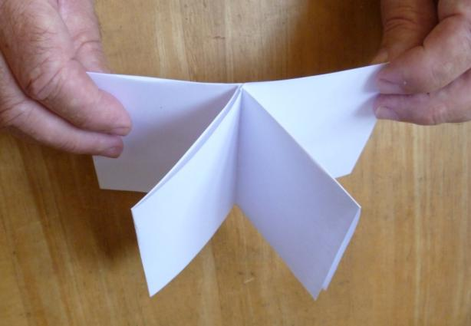
And there it is!
Notes:
Push until the paper folds right up into a little book. Bring the outside pages around to form the covers, and press the folds neatly into place.
At this stage each participant should be holding a completed basic little book.
It is a good idea for each participant to mark (in pencil) each page and the front and back covers of the little book. This will help them to remember which way up each page is and where to put the pop-ups.

Slide 10
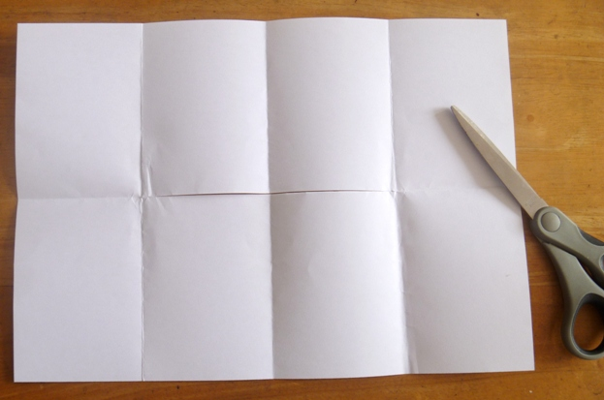
Folding for pop-ups:
Unfold paper completely
Fold edges in to the middle
Notes:
With the pages and covers marked (as suggested in the previous note), unfold the paper completely.
With the paper in ‘landscape’ position, fold the two outside edges to the middle of the paper.
(The cut section will be (horizontal) in the section of paper underneath, flat on the table.

Slide 11
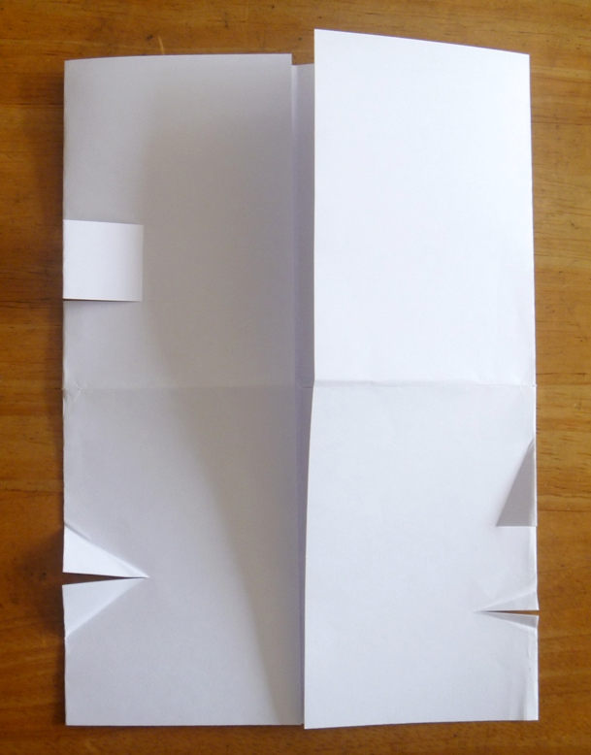
Little cuts for pop-ups:
Book Cover
(no cuts)
Box
Nose
Mouth or beak (duck)
Mouth
Notes:
Cuts and folds can be added to 3 of the 4 the folded edges – not the front/back cover section.
Participants need to plan their story and pages before they make the cuts. (Previous experience in sessions 1 and 2 mill enable them to do this.)
The following slides show some examples of pop-ups.

Slide 12
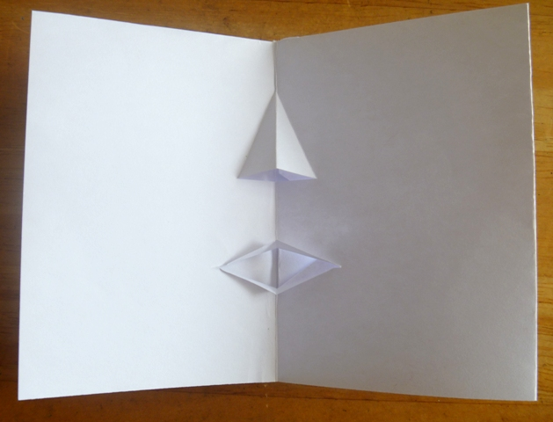
Face – nose and mouth pop-ups
Notes:
As with the pop-up card, creating a face for a character in the book requires 2 small cuts.

Slide 13
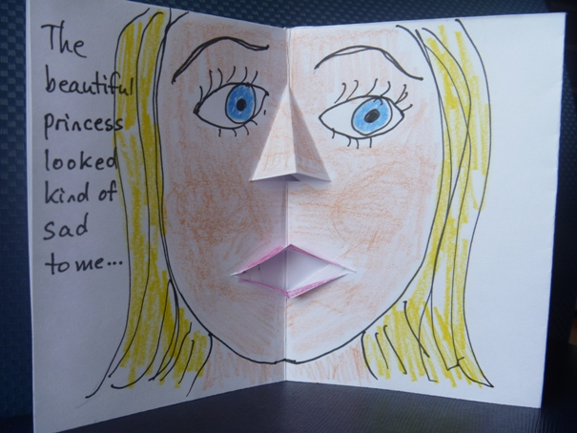
A character quickly develops
Notes:
Drawing and writing will add interest to the pop-up page.
It is worth noting at this point that where the pop-up reveals a space (such as the inside of the mouth), the book-maker can choose to also add colour or drawing inside the space on the page behind – taking care not to affect other pages.

Slide 14
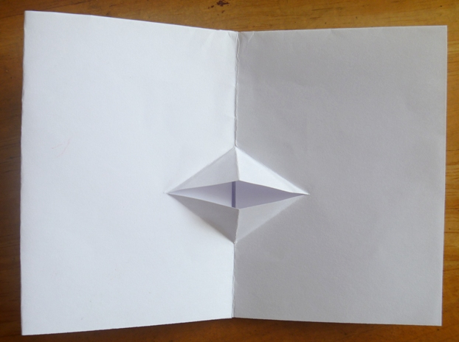
Duck Beak or Animal Mouth
Notes:
A single cut produces the form of a mouth or beak. Altering the position (higher/lower on the fold) and/or length of the cut and/or size and angles of the folded triangles will change the ‘character’ of the mouth.

Slide 15
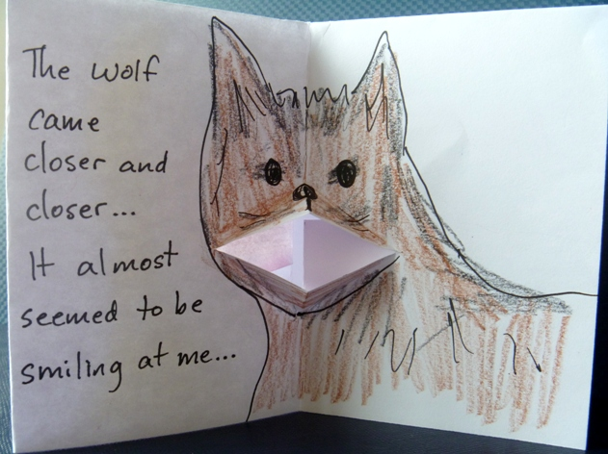
Any animal will do
Notes:
The drawing, colouring and writing complete the effect. (Again colouring or drawing could be carefully added inside the mouth area.)

Slide 16
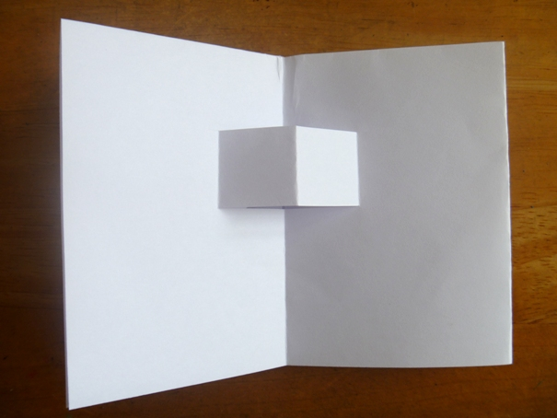
Box or Furniture or Item
Notes:
Two cuts are needed to make a ‘box’ shape.
A straight cut at the bottom and an angled cut at the top (with a fold parallel to the fold edge) can produce a traditional house shape with a sloping roof.

Slide 17
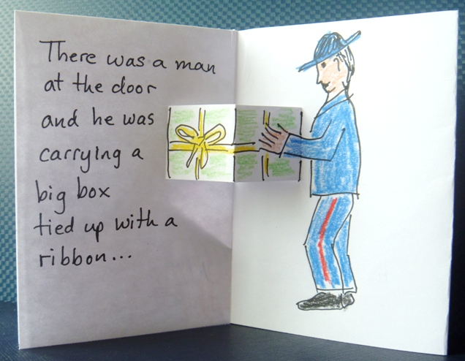
Something cube-shaped
Notes:
Here the box shape has been drawn in to become an interesting gift, full of mystery.

Slide 18
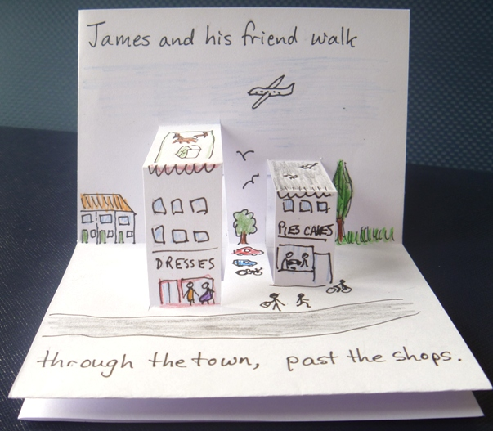
Design your story and pop-ups to go together.
Notes:
Turning the book to ‘landscape’ format allows the box pop-ups to become buildings of different sizes.

Slide 19
There doesn’t have to be a popup on every page.
Notes:
Participants may choose to only put a pop-up on one or two of the three internal (double) pages, allowing more room for telling the story.

