Slide 1
Rethinking English Language Reading Learner Resources in Terengganuan Schools
Researched and presented by Peter Wickham, English Language Training Fellow of Brighton Education LS
and
Pn Hjh Zaliha Bt Abdullah, lecturer at Institut Pendidikan Guru Kampus Dato’ Razali Ismail, Kuala Terengganu, Malaysia.
Notes:
Hello and welcome to our presentation of Rethinking English Language Learner Resources in Terengganuan Schools.
Over the past 12 months Puan Zaliha and I have been researching reading material in primary schools in Kuala Terengganu, with some not very surprising results, which Zaliha will present to you in a moment.
After that I will return to the podium to suggest some innovative ideas on how to improve the situation to the benefit of our students.

Slide 2
Kuala Terengganu Fellows
KTF2012.weebly.com
Notes:
Firstly let me introduce you to our website. If you do not take another note away from this presentation, at least take this.
When you get back home, go to this website KTF2012.weebly.com just as it appears there, with no www or anything else in front of it.
There you will find a tab called MELTA 2012. Click on that and locate the full text of our paper, and also the full PowerPoint show that you see on the screen now.

Slide 3
Susser, B., & Robb, T. (1990).
EFL Extensive Reading Instruction:
Research and Procedure. JALT Journal,
Vol. 12, No. 2 (November 1990).
Extensive Reading
Notes:
Because our time is rather short here today, I want to only direct your attention to research by Susser and Robb 1990 on the subject of (click) Extensive Reading. Extensive Reading is an area of language learning that has at the same time received a lot of attention in recent years by researchers, a lot of attention in Western countries, and yet little attention in Malaysia. For reasons that we will look at very briefly in a moment, Malaysian curricula, schools and teachers put little effort or time into encouraging this most important area of Extensive Reading.

Slide 4
Our working definition of "extensive reading" as a language teaching/learning procedure is that it is reading
of large quantities of material or long texts;
for global or general understanding;
with the intention of obtaining pleasure from the text…
reading is individualized, with students choosing the books they want to read,
the books are not discussed in class.
Notes:
In the course of their studies Susser & Robb developed five main descriptors of Extensive Reading:
(Click) longer texts
(Click) general reading rather than specific topics
(Click) pleasurable reading
(Click) students choosing their own texts
(Click) not material that is dealt with in class
This stands in stark contrast with the kind of reading lesson that I have observed in Malaysian classes, where Reading Comprehension from specific texts is the norm, along with Reading Aloud , and grammar lessons.
In short, Extensive Reading is the opposite of what passes for reading lessons in most of our classrooms, where a specific piece of literature is chosen by the teacher, specific questions are devised by the teacher, and students are taught to search out specific answers to these questions, often with a Reading Aloud session.

Slide 5
The Internet TESL Journal, Vol. IV, No. 12, December 1998 http://iteslj.org/
Extensive Reading: Why? and How?
Timothy Bell timothy [at] hsc.kuniv.edu.kw Kuwait University
Notes:
Again, because we have only a brief time together, I present to you a short piece by Timothy Bell published in the Internet Journal in 1998 on Extensive Reading. This piece is representative of a much wider range of writings on the subject.

Slide 6
Extensive Reading - Timothy Bell
can provide 'comprehensible input'
can enhance learners' general language competence
increases the students' exposure to the language
can increase knowledge of vocabulary
can lead to improvement in writing
can motivate learners to read
can consolidate previously learned language
helps to build confidence with extended texts
encourages the exploitation of textual redundancy
facilitates the development of prediction skills
Notes:
Let me encourage you to read Bell’s treatment of this subject of Extensive Reading. The full citation is found in the reference section of our paper which is found on the website I gave you earlier, KTF2012.weebly.com which is printed for you on the handout sheets available at the door.
These 10 points of educational advantages of Extensive Reading are each worthy of note. Two in particular drew my attention:
(Click) Separate research points out that number 5 on this list, Improvement in Writing, tends to happen automatically when students read extensively as defined earlier. The area of Writing is central to any general education, and demands a lot of a teacher’s time each week. A spin-off of Extensive Reading is an improvement in the student’s writing ability.
(Click) Another interesting result of Extensive Reading worth a special note is number 9, the Exploitation of Textual Redundancy. This means that the reading of longer texts requires a different skill set than intensive reading of shorter texts, and better approximates normal speech patterns. Reading several different short passages in a row does not equal reading one longer passage.

Slide 7
The best methods are therefore those that supply 'comprehensible input' in low anxiety situations, containing messages that students really want to hear.
- Krashen, S. (1987)
Notes:
This is very much backed up by earlier work by the famous Stephen Krashen. Perhaps my favourite quote from Krashen on the subject of the best method of teaching English is just this:
“The best methods are therefore those that supply 'comprehensible input' in low anxiety situations, containing messages that students really want to hear.”
Behind this statement lies a universe of research that has been pointing us in this direction for the best part of five decades. When students are placed into a situation where they have access to stimuli by eye and/or ear that they have a burning desire to see and hear, and when they feel no fear from external agents such as teachers, parents or fellow students, then they are in the best position to learn.
We as teachers are often guilty of applying such pressures and fear of failure on our students that learning is all but impossible. Failure leads to fear, and fear to more failure. It is a vicious cycle that many of us can relate to, and certainly one that we have all seen in action among our students.

Slide 8
How do I provide for Extensive Reading?
How do I assess it?
Notes:
The lack of Extensive Reading in Malaysian Schools does not just happen by itself. Teachers naturally ask the important and responsible questions, “But how do I provide for and assess Extensive Reading? How can I know whether my students really are reading extensively? I can’t see what they are learning, and I can’t find out unless they tell me. If the text is not discussed in class, how can I find out if they have really read it? If they choose their own material, how do I know whether it is suitable to their age, reading proficiency and interests? How do I know if it is morally acceptable material?”
And the answers to these questions are not generally there. It would seem irresponsible for teachers to allow students the freedom to choose their own reading material without proper suitability checks, and irresponsible for teachers to allow activities that they cannot test or control. I agree with these concerns up to a point.
The answers are in the pipeline. Keep checking our website for answers. In short, testing is done by way of reading checklists and either written or verbal book reports on the story’s characters, setting, plot, resolution and the lesson or moral learned by the reader. There are many resources on the internet from overseas Education Departments on the subject of assessment of reading, including students’ extensive reading.
An important point to note here is that we are interested primarily in students being exposed to literature in English language, not in the content of the written material. Extensive reading is a goal in itself; much of a student’s learning about the English language stems from this exposure rather than from formal lessons in grammar and syntax.
The question of provision of suitable material is the one we decided to attack first, since it is the rate determining step. Without suitable material to read, the reading simply will not take place.

Slide 9
Interest?
Engagement?
reading material
Notes:
Pn Zaliha was a school librarian in Malaysian schools for many years. She shares my love of reading for pleasure. I taught primary school students in Australia for 20 years. We both know from personal experience and from years of observation of school students that those who read extensively do well in all areas of learning. It is easily observed by any teacher that those students who shine at school will have outside interests and hobbies, and have a natural love of discovery and inquiry into things they observe around them within the sphere of their lives. The joy of discovery soon leads to inquiry into objects and events outside of their own experience, and they are well on their way to being independent learners.
One common factor among these students is usually that of Extensive Reading. Our inquiry into English Language reading habits of Malaysian students began with the question of what reading material is available to them. Even the most enquiring of minds cannot read what they do not have. And what they have must be engaging in order to be effective. Our first target in this project was to determine quantitatively what book titles are available to Malaysian school students within their school environments.
I now invite Pn Zaliha bt Abdullah to explain our methods of research and our findings into reading materials available to students in schools in Kuala Terengganu.

Slide 10
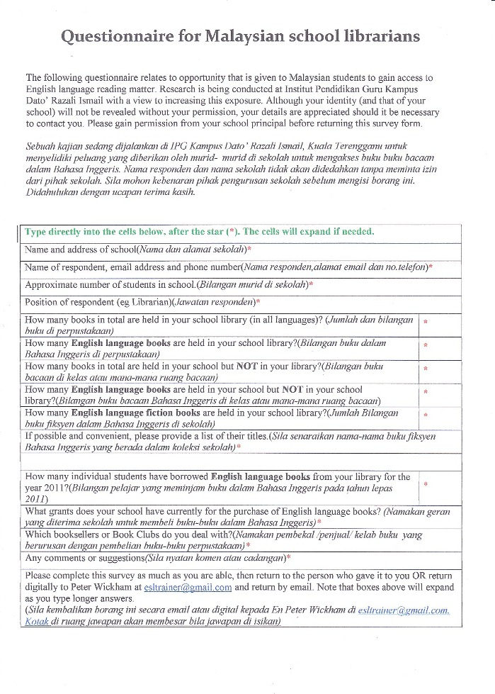
Notes:
This is the second draft of our e- questionnaire, after I edited to include questions in Bahasa Malaysia. In the initial stage I went to three nearby schools to meet the respondents. It was so tiring meeting them between lectures and after school. Then I held a meeting with the BTPN (The State Technology Education Division) in Marang. The Director of BTPN Terengganu ,Tn Hj Alias and his officer En.Zaidan agreed to help us to upload the questionnaire and be assessable to the multimedia teachers in –charge of their schools. Later Cik Anita ,the PKG Tok Jiring officer sent our e- questionnaire to secondary and primary schools in Kuala Terengganu District.

Slide 11
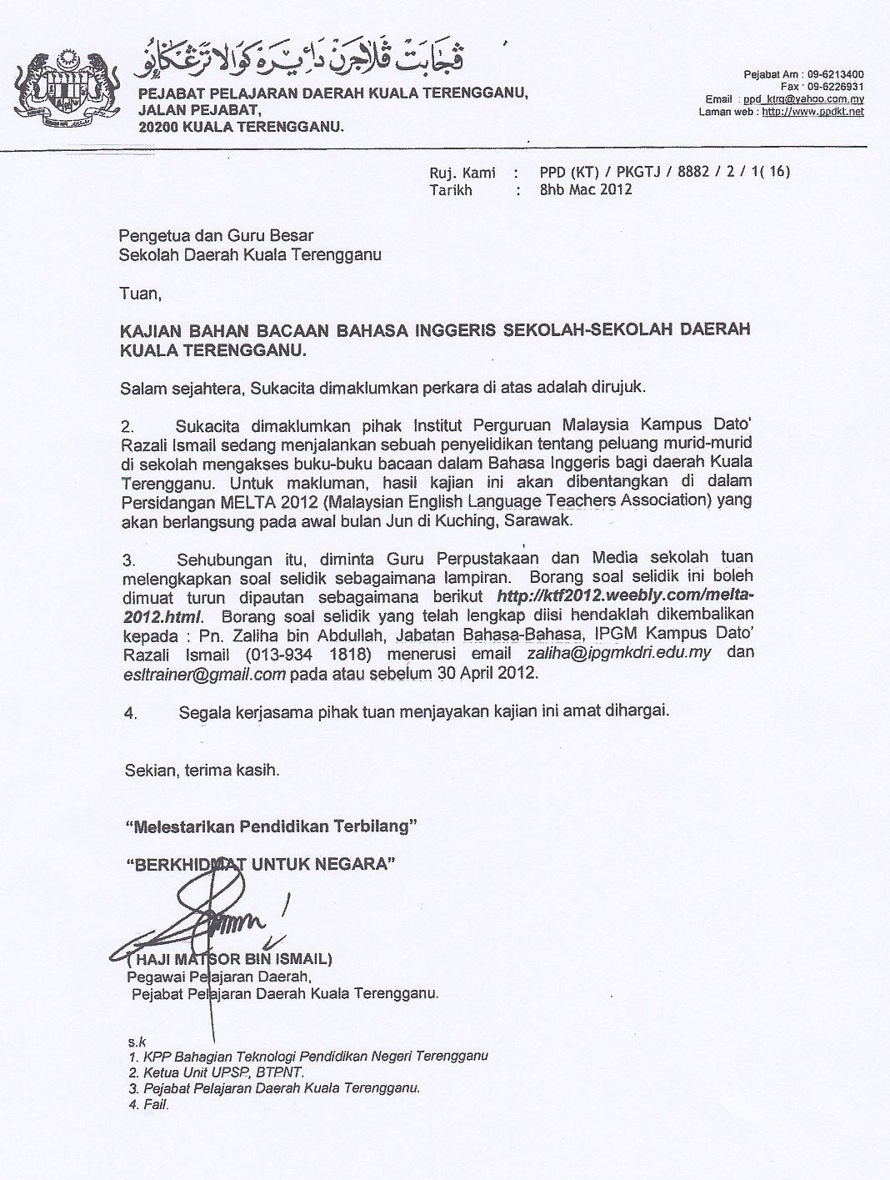
Notes:
This is the official letter we received through the email form the Kuala Terengganu District Education Officer mentioning our MELTA presentation.

Slide 12
 | No of students | Books in Library | Eng Lang Bks in lib | Eng Lang Bks not in Lib | Eng Fiction in School | Borrowers Eng Lang Bk in 2011
School 1 | 541 | 9000 | 2865 | 1083 | 1800 | 162
School 2 | 347 | 142600 | 4750 | 15 | 3000 | 50
School 3 | 93 | 10990 | 5000 | 2000 | 3000 | 100
School 4 | 537 | 12387 | 4053 | 270 | 3057 | 65
School 5 | 1015 | 22000 | 8000 | 500 | 2500 | 400
School 6 | 814 | 14521 | 6618 | 511 | 4513 | 45
School 7 | 163 | 5155 | 1820 | 10 | 1020 | 50
School 8 | 163 | 5000 | 2000 | 50 | 1500 | 32
School 9 | 623 | 6655 | 1777 | 40 | 200 | 120
School 10 | 715 | 28921 | 2000 | 500 | 1500 | 150
Notes:
The next 2 slides are our findings from 19 schools we get through the e-questionnaire. Look at the highlighted- three columns: the one in green, in red and purple.

Slide 13
 | No of students | Books in Library | Eng Lang Bks in lib | Eng Lang Bks not in Lib | Eng Fiction in School | Borrowers Eng Lang Bk in 2011
School 11 | 308 | 3141 | 2564 | 500 | 300 | 140
School 12 | 261 | 13350 | 6630 | 1000 | 3710 | 180
School 13 | 170 | 5001 | 2010 | 400 | 200 | 300
School 14 | 280 | 7000 | 2000 | 1000 | 1500 | 40
School 15 | 458 | 10000 | 2500 | 1000 | 600 | 30
School 16 | 1034 | 10000 | 700 | 200 | 350 | 5(0.48%)
School 17 | 1300 | 20000 | 5000 | 2000 | 1200 | 200(15.4)
School 18 | 1300 | 9000 | 2500 | 500 | 1500 | 20(1.54)
School 19 | 715 | 8750 | 1200 | 145 | 530 | 110(15.4)
Average | 570.4 | 18077.42 | 3367.7 | 596 | 1683.2 | 115.7
Notes:
The number in green reflects the number of books we have in our school libraries. Quite a number to say, from 3,000 to 142,000.
Now look at the number in red: this is the number of English Fiction in our libraries: from a mere 200 to 4,000 books only. This is the real situation in our school library .
And the last column is the number of Borrowers of English Language Books in 2011: from 20 to 400.which sums up to an only
0.2 books per student!

Slide 14
Discussion of Findings
19 out of 119 expected respondents(16%)
15 Primary schools : 4 secondary schools.
The average books : 18,077 books.
The average number of English Language Books : 3,276 books.
Only 1,683 English Fiction 9.3% of all the books in the library.
In summary we have a RESULT: only 0.2 books per student who read English Fiction.
Notes:
This is the findings from our research. Taking the average of every item from the 19 schools and focusing on the text in red: There is an average of 570 students with 18,000 books but only 1,683 English Fiction which is only about 9.3% of all the books in the library. In summary we have a
Result : only 0.2 books per student who read English Fiction.

Slide 15
Reasons for Low Percentage of English Fiction Book Borrowers
Difficulty in good and interesting books - List of fiction book titles not easily available.
English Fiction not available in bookshops in Kuala Terengganu
Not much book distributor or publisher promotion.
Notes:
I have listed out 4 reasons for the low percentage of English fiction book borrowers:
First.: difficulty in getting good and interesting books as list of fiction titles not easily available.
Second : The bookshops in Kuala Terengganu are not selling enough English Fiction books to cater for both primary and secondary schools.
And Thirdly : Main book distributors and publishers from KL seldom come to our rural schools to promote their English fiction books.

Slide 16
Literature
2003 Reading Programme by the KPM
Structured Early Reading(Ladybird and Sound Start series for Year 1) , Extensive Reading(year 3,4,5,6) and Contemporary Literature Reading (Year 4,5,6)
Notes:
There was a Reading Programme (Ali, 2003) conducted by the KPM when ETeMS started in 2003: Structured Early Reading(Ladybird and Sound Start series for Year 1) , Extensive Reading(year 3,4,5,6) and Contemporary Literature Reading (Year 4,5,6)
Lots of reading materials were distributed to underachieved schools and schools in remote areas . We have yet to find the feedback from this reading programme.
However, a librarian from a primary school nearby our campus reported that all the books that they received through this reading programme was not included as the property of the library.
The books were allocated in the Self-Access Centre and only English teachers and their pupils who go there can access the books.

Slide 17
Possible Solutions
1. Book Club
www.scholastic.com
Notes:
The first thing I found absent from local schools was participation in Book Clubs. At first I had the impression that Book Clubs do not exist in Malaysia. After some time of searching I discovered that at least one does operate, a Malaysian version of the main Book Club that operates in Australia with great success for the company, for schools, and best of all, for the students.

Slide 18
http://scholastic-asia.com/scholastic/images/cC320_2988.jpg
Notes:
An internet search reveals instructions for school librarians to apply for membership of their school to a Book Club.
Let me remind you that the full set of slides and notes is found on the website KTF2012.weebly.com, so these websites and references are there for you to refer to later.
This may not be the only Book Club for school students in Malaysia, but so far it is the only one that I am aware of. If anyone here today knows of others, I would be very glad to receive the details.

Slide 19
http://www.scholastic-asia.com/scholastic/images/cC1335_5383.jpg
Notes:
Books suitable for all ages are displayed in a catalogue sent free to each school, one for each student.

Slide 20
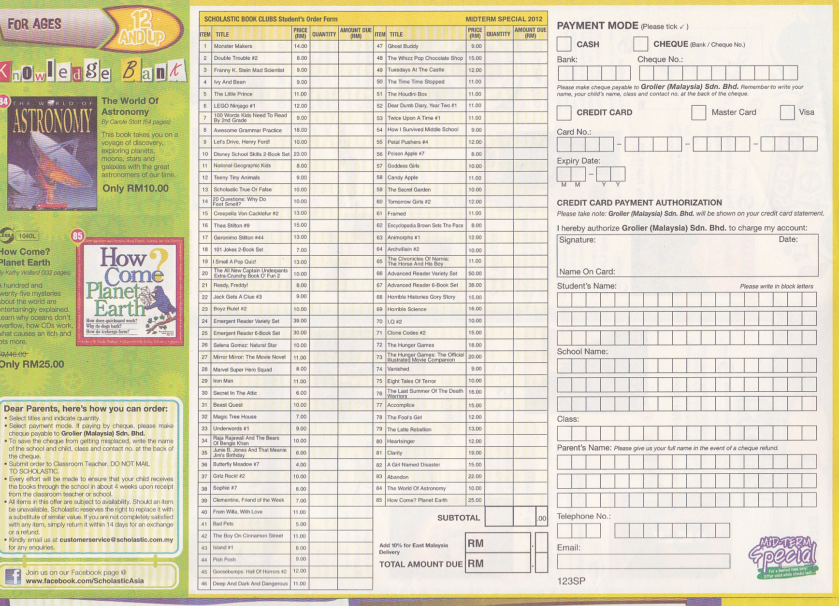
Notes:
Each student, after discussions with their parents, brings the order form and money back to school, where the total order is collated into one.
A month later the books with individual students’ names attached, are delivered to the school.
Schools and classes are allotted bonus points for free books in future orders.
Not all books will be suitable, or approved by parents. But over time, more English language reading material will be present within the educational community. Books can be passed on to younger siblings, swapped with friends, or donated to the school library. In a school of 400 students for example, if every student bought even one book each on the average, there would be 400 more English language books in circulation for each year. That is more English language fiction books presently in some school libraries!
Because students own the books, the books would be stationed at home and be available for parents and siblings to inspect.
Book prices tend to be around the RM6-10 range.
This by itself would vastly increase the availability of reading material quite quickly.

Slide 21
Possible Solutions
1. Book Club
2. Make your own
Notes:
(Click) A second and, for today, final solution to lack of suitable English language reading material in Malaysian schools exists within easy reach.
It is available to every school library, individual student, and teacher in all of Malaysia.
It is not free, but extremely low cost.
It is reproducible to anyone with a computer printer/scanner.
Once scanned, it is emailable and uploadable and downloadable to and from websites.
Every book will be deemed suitable by the teacher of the class.
The downside? Just this: it will take some time and effort by the teacher.

Slide 22
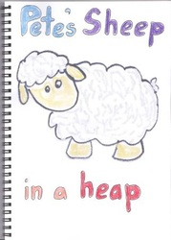
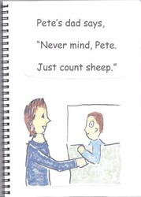
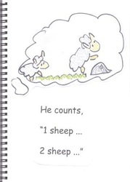
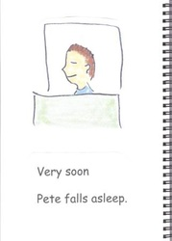
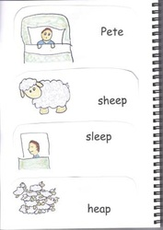
storiesformalaysiankids.weebly.com
Notes:
storiesformalaysiankids.weebly.com contains material produced by Mrs Ruth Wickham, who, like myself, is an English Language Training Fellow at IPGKDRI in Kuala Terengganu. She is working with lecturers to lead trainee teachers into the art of manufacturing books in the classroom. The stories can come from the teacher, or from students, or borrowed from other schools.
If you have the opportunity, look into this website, and certainly attend Ruth’s workshop at this conference to learn much more about this art.

Slide 23
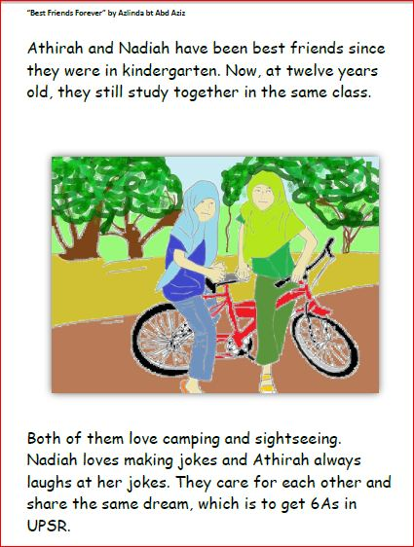
Notes:
The local content of these locally produced reading materials automatically stimulates interest from students. While using English language, local names of people and places, and incorporation of local customs and activities allow students comprehensible input in English in a low anxiety context.
As any good author knows, it is so important that readers identify with a character in the story. A boy of 10 finds it difficult to identify with female characters such as these, or with an elderly grandfather figure, or with a Western businessman.
Age, gender and culture of the characters in a story matter enormously to the reader by way of identification of the reader with one of the characters, as does the plot of the story. Traditional stories often provide an identifiable age, gender and culture, but fall down with a disjointed plot that is difficult to follow.

Slide 24
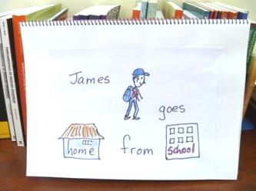
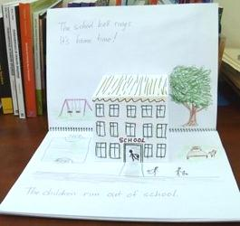
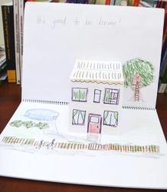
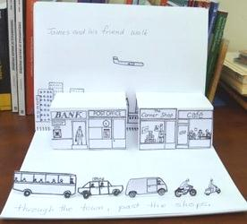
Notes:
Making your own little books can lead to all sorts of fascinating formats such as pop-out books, concertina fold books and other novelties that children just love to read. Remember that when students are enjoying themselves, learning is taking place. All we as teachers can do is to encourage learning, and provide the best learning environment for our students.
If 100 teachers attended a workshop and produced one book each, all 100 teachers could return to their school with 100 books. We are currently looking at very short stories until expertise in story production, and physical book manufacture techniques are established, then perhaps we can branch out into longer children’s books. Lecturers at IPGKDRI in Kuala Terengganu have already begun instructing their students in this Language Art.
There is one other area of access to suitable English language reading material for Malaysian students that I consider is set to become more prominent over the next few years.

Slide 25
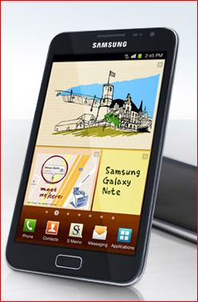
Notes:
Access to e-Books is a possibility. That is, books that are downloaded onto a laptop or other electronic reading device such as the Amazon Kindle or the Samsung Galaxy Note.

Slide 26
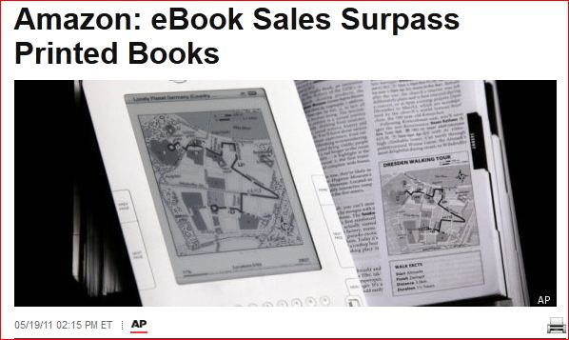
http://www.huffingtonpost.com/2011/05/19/amazon-ebook-sales-surpas_n_864387.html
Notes:
Amazon in May last year reported that it had for the first time ever sold more e-books than paper books in the previous 12 months.
Although many people like to enjoy the tactile experience of holding a book and physically turning pages, we have to face the fact that e-books are making huge inroads into worldwide reading habits.
Electronic reading devices are becoming cheaper, while paper books are becoming ever more expensive. Before too long we will be forced to consider this source of reading material as the major option.
This is an area of research that we did not explore, but would make a very interesting follow-up study.

Slide 27
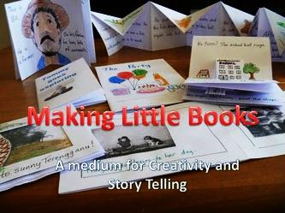
http://acollectionofteslresources.weebly.com/making-little-books-basic-book.html
Notes:
In the meantime, follow the links on KTF2012.weebly.com for directions on how to make your own reading books.
You can include your own photographs and drawings, drawing by students, and edited versions of your students’ stories. All of this will vastly increase students’ interest in reading English language material. These locally-produced books can also be presented as e-books, read on computer or e-reader screens. Even hand-drawn and hand-written texts can be scanned and presented electronically when required. Access your local ITC specialist for instructions
You will find that students will automatically head for this reading material because of its high interest, low anxiety content that students really want to hear.

Slide 28
The best methods are therefore those that supply 'comprehensible input' in low anxiety situations, containing messages that students really want to hear.
- Krashen, S. (1987)
Notes:
Sound familiar?
On behalf of Pn Zaliha and myself, thankyou for listening.
We hope that you are inspired to seek out ways of providing your students with engaging, stimulating English language reading material which they will want to take away and read for enjoyment.

