Slide 1
Strategies to Improve Conversational English
Session: “Ask Around”
Notes:
Asking and answering questions is a vital part of conversing. However, forming an appropriate question can be quite complex.

Slide 2
Asking questions
Notes:
There are a number of different types of questions in the English language, which can be confusing and frustrating for learners of English. The type of question depends on the expected type of answer.
And then further complications can be encountered in selecting the appropriate verb tense in the question form.
(This session does not cover all types of questions, just a few that will be useful for our survey.)

Slide 3
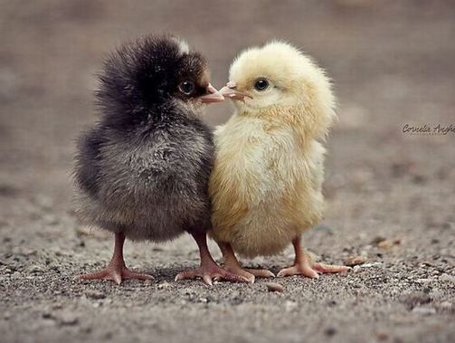
Yes / No questions
Notes:
The simple question expects a ‘yes’ or ‘no’ answer.
DO YOU … ? (simple present tense) for when you are asking about habits and routines.
DID YOU … ? (simple past tense) for when you are asking about an even at a specific time in the past.

Slide 4
Do you … ?
Yes, I do.
No, I don’t.
Did you … ?
Yes, I did.
No, I didn’t.
Notes:
The answer is “yes, I do/did” or “no, I don’t/didn’t”.

Slide 5
Practice 1 & 2

Slide 6
Have you ever …?
…seen / been to / eaten / done etc. (Note: use the participle)
Notes:
The present perfect tense is a confusing mixture of present and past! We use ‘have’ as an auxiliary, and the past participle form of the verb.
An easy way to use this form – especially for our survey – is to ask the question “Have you ever …?”

Slide 7
Yes, I have.
No, I haven’t.
Notes:
It’s a yes/no question, and the answer is “Yes, I have.” or “No, I haven’t.”

Slide 8
Practice 3

Slide 9
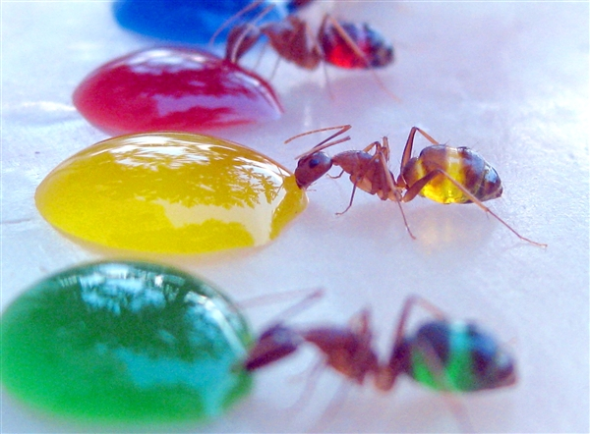
Open questions
How many?
Where?
When?
How?
Why?
What?
Which?
Who?
Notes:
We do a lot of practice with open questions, which are characterised by using question words such as
Why?
When?
Where?
What?
Which?
Who?
How?
How many?
How often?
Note: In most situations the question word is followed by ‘do’ or ‘did’.
If the answer is the subject of the sentence, there is no do/did. E.g. ‘Who hit you?’ In the question ‘Who did you hit?’ the answer is the object of the sentence.

Slide 10
‘Wh’ questions -
many different answers
Notes:
The problem that arises with using open questions in a survey is that you can get such a large range of answers it makes your data unmanageable. The solution is to then classify and group the answers, or start by asking multiple choice questions.

Slide 11
For a survey it may be best
to give multiple choice.
Notes:
When you get ten totally different answers, you could try to reduce it to 3 or 4 groups of similar answers.
OR when design the question with a few Multiple Choice options (one of them could be ‘other’).

Slide 12
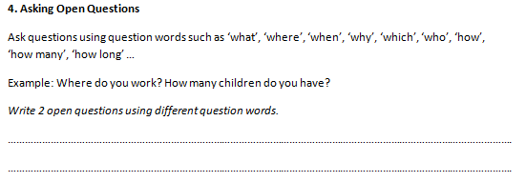
Practice 4

Slide 13
T O P I C S
Food and eating habits
Transport and travel
Clothing and fashions
Family and friends
Houses, rooms, furniture
Work and employment
Education
The future
TV and movies
Reading books and novels
Favourite music

Slide 14
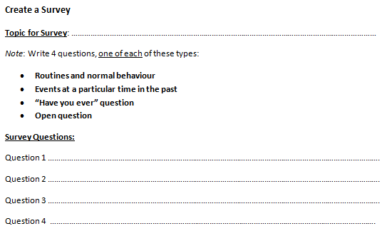
Create Your Survey

Slide 15
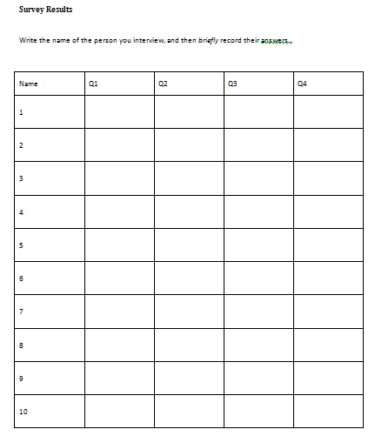
R E S U L T S

Slide 16
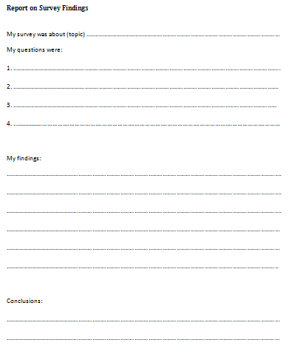
R E P O R T

