Slide 1
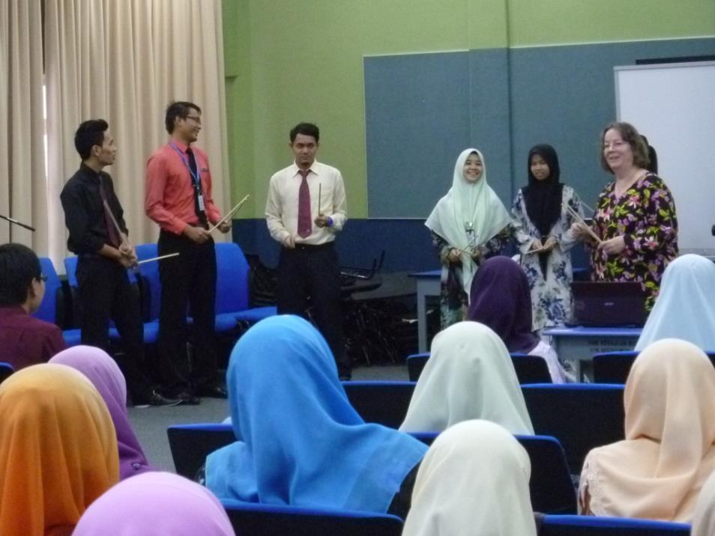
Songs and Poetry for Young Learners
Workshop 2013

Slide 2
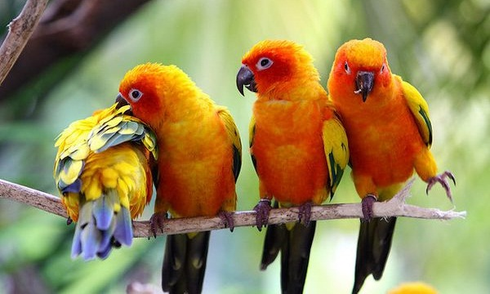
Pass the Beat

Slide 3
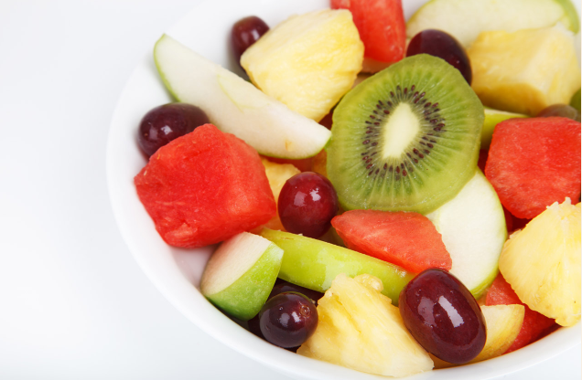
Fruit Salad

Slide 4
Apples, peaches, pears and plums!
Apples, peaches, pears and plums!
Banana-na-na-na-na-na!
Banana-na-na-na-na-na!
Grapes, grapes, doo-ah doo-ah!
Grapes, grapes, doo-ah doo-ah!
Papaya, papaya, p-p-papaya!
Papaya, papaya, p-p-papaya!
Watermelon, watermelon, (spit out seed, spit out seed)
Watermelon, watermelon, (spit out seed, spit out seed)
Raspberry, raspberry, (raspberry, raspberry, raspberry)
Raspberry, raspberry, (raspberry, raspberry, raspberry)

Slide 5
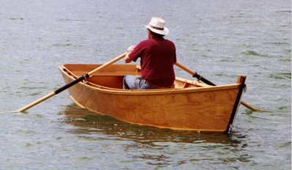
Row, Row, Row your Boat

Slide 6
Sing a Round
1. Row, Row, Row your boat
2. Gently down the stream.
3. Merrily, Merrily, Merrily, Merrily
4. Life is but a dream.
Singing a round:
2 groups
First group starts singing on 1 and keeps going, Second group starts on 3.
4 groups
First group starts singing on 1 and keeps going, Second group starts on 2,
Third group starts on 3, Fourth group starts on 4.

Slide 7
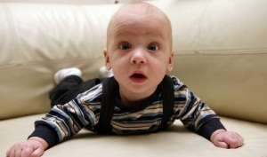
Alive, Alert, Awake, Enthusiastic

Slide 8
I'm alive, alert, awake, enthusiastic
I'm alive, alert, awake, enthusiastic
I'm alive, alert, awake,
I'm awake, alert, alive,
I'm alive, alert, awake, enthusiastic!
          Actions:
          Alive: hands on your head
          Alert: hands on shoulders
          Awake: cross arms over chest
          Enthu-: hands on thighs
          -si-: clap
          -astic: snap with both hands
    I am dead to the world and very sleepy …
    I am dead to the world and the world is dead to me
    I am dead to the world and very sleepy

Slide 9
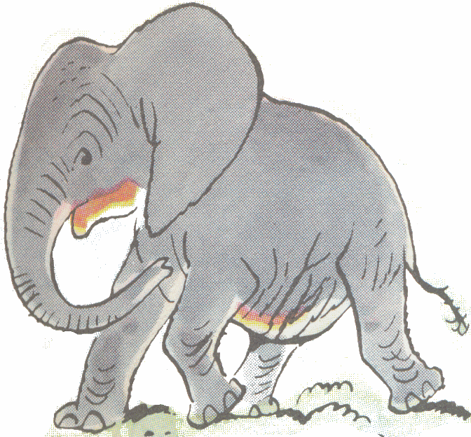
Elephant Song

Slide 10
What is that noise? (cup hand to ear)
Up in the attic (point over your head)
It is an elephant (make a trunk with your arm)
Cycling round and round. (cycling motion with legs)
It is an elephant (make a trunk with your arm)
All chic and elegant (fashion model pose)
With one tail here (make trunk with your arm)
And one behind. (point to where your tail would be if you had one!)

Slide 11
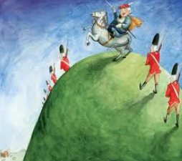
Grand Old Duke of York

Slide 12




Oh the Grand Old Duke of York,
He had ten thousand men,
He marched them up to the top of the hill
And he marched them down again.
And when they were up, they were up.
And when they were down, they were down.
And when they were only halfway up,
They were neither up nor down.

Slide 13
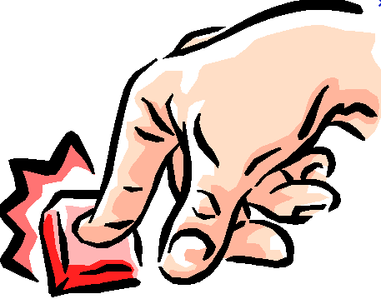
Hello, My Name is Joe

Slide 14
Hello, my name is Joe
I have a wife and a dog and a family
I work all day in the button factory
One day, my boss came up to me and said,
"Hey Joe, are you busy?"
I said, "No … no!"
"Then do this..."
While punching a button with each finger, each foot, and your head:
      Hello, my name is Joe
      I have a wife and a dog and a family
      I work all day in the button factory
      One day, my boss came up to me and said,
      "Hey Joe, are you busy?"
      I said, "YES!!”
… And collapse as if exhausted.

Slide 15
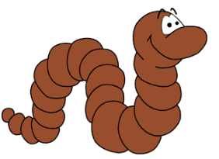
Herman the Worm

Slide 16
I was sitting on my fencepost, chewing my bubble-gum (chew, chew, chew, chew)
Playing with my yo-yo, wee-oo! wee-oo! (action playing with yo-yo)
When along came Herman the worm (finger-worm coming along like inch-worm)
And he was this big (show tiny size with fingers)
And I said: "Herman? What happened?" (use voice expression)
"I ate my Mother."
repeat verse, with worm action getting larger and larger for each of the following lines:
"… I ate my Father." (hand-sized worm)
"… I ate my Brother." (fore-arm sized worm)
"… I ate my Sister." (whole are sized worm)
"… I ate my Dog." (whole body / two-arm-size to show)
Repeat verse one last time, with a tiny worm action for:
"I burped."

Slide 17
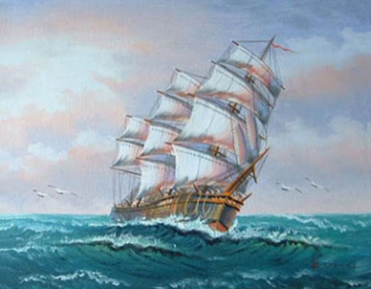
A Sailor Went to Sea

Slide 18
* * *
A Sailor went to sea, sea, sea,
* * *
To see what he could see, see, see,
* * *
And all that he could see, see, see,
* * *
Was the bottom of the deep blue sea, sea, sea.
* * *
A sailor went to chop chop chop ...
...knee... ...foot... ...Timbuktu...

Slide 19
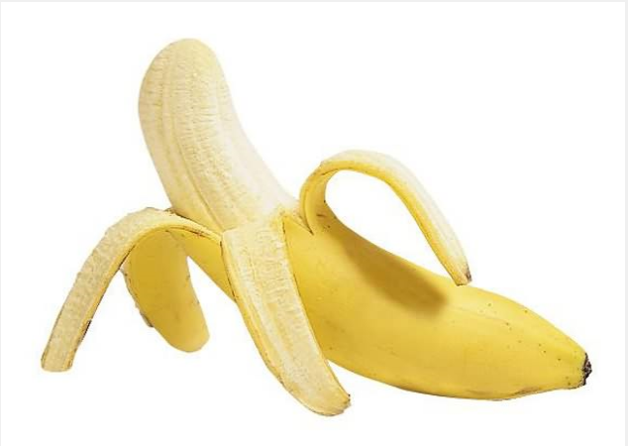
No Bananas in the Sky

Slide 20
There are no bananas in the sky, in the sky
There are no bananas in the sky
There's a sun
And a moon
And a coconut cream pie
But there are no bananas in the sky, in the sky!
Actions:
No: hand motion both hands together then apart (like "cut" for a movie, sort of)
Bananas: peel a banana
In the sky: point upward on sky (each time)
Sun: gesture a round object in the sky
Moon: another round object on the other side
Coconut cream pie: gesture a fluffy object (like clouds)
      There are (action) (action) in the (action) in the (action)
      There are (action) (action) in the (action) in the (action)
      Just a (action) and a (action) and a (action)
      But there are (action) (action) in the (action) in the (action).

Slide 21

Oh Chester

Slide 22
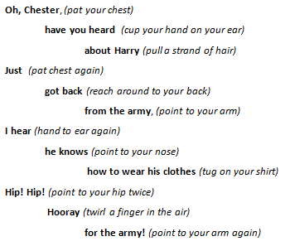

Slide 23
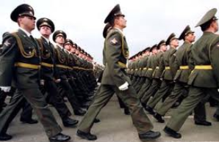
Left Right Left!

Slide 24

I had a good home and I left
I had a good home and I left
I left on my own and it served me right,
Left, right left right.

Slide 25
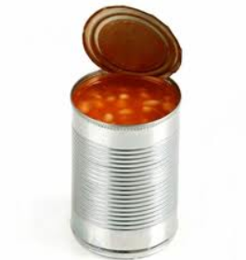
Left! Left!
I left my wife in New Orleans
With thirty-five kids and a can of beans.
I thought it was right, right,
Right for my country. Whoop-dee-doo!
Left! Left!
I left...

Slide 26
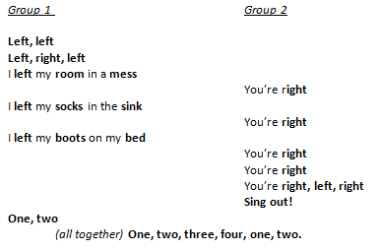

Slide 27
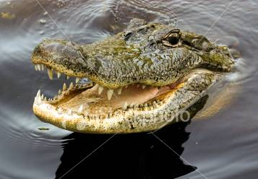
Crocodile Song

Slide 28

She … sailed away (Draw lady shape for ‘she’. Then hand shows waves motion)
On a fine and sunny day (hands make circle for sun in the sky)
On the back of a crocodile. (pat your own back, then use arms for crocodile jaws)
You see, said she, (point for ‘you’, then to your eyes for ‘see’, draw shapely woman for ‘she’)
He's as tame as tame can be, (stroke back of hand and arm)
I'll ride him down the Nile. (riding action like horse)
The crock winked his eye (croc jaws with arms, then point to eye and wink)
As the lady waved goodbye, (wave goodbye)
Wearing a great big smile. (draw oversized smile on your face)
But at the end of the ride (pat bottom for ‘end’, riding motion for ‘ride’)
The lady was inside (lady shape then pat tummy)
And the smile was on the crocodile! (draw smile, then arms for crocodile jaws)

Slide 29
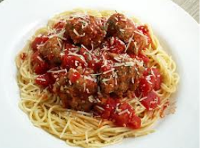
On Top of Spaghetti

Slide 30
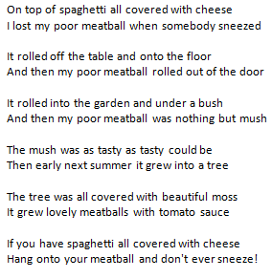

Slide 31


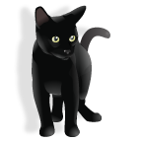
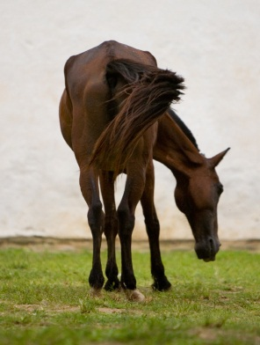
There was an old lady

Slide 32
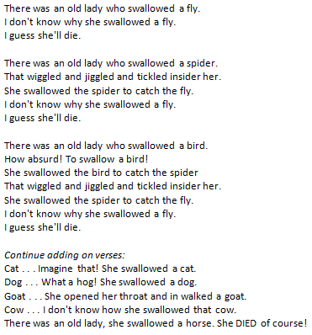

Slide 33
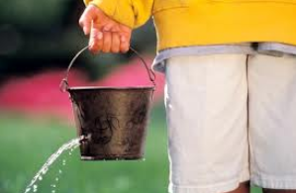
There’s a Hole in my Bucket

Slide 34
Henry: There's a hole in my bucket dear Liza, dear Liza
There's a hole in my bucket dear Liza, a hole.
Liza: Well, fix it dear Henry, dear Henry, dear Henry,
Well, fix it dear Henry, dear Henry, fix it.
Henry: With what shall I fix it? ...
Liza: With a straw dear Henry ...
Henry: The straw is too long ...
Liza: Well, cut it dear Henry ...
Henry: With what shall I cut it? ...
Liza: With an axe dear Henry ...
Henry: The axe is too dull dear Liza ...
Liza: Well, sharpen it dear Henry ...
Henry: With what shall I sharpen it? ...
Liza: With a stone dear Henry ...
Henry: The stone is too dry dear Liza ...
Liza: Well, wet it dear Henry ...
Henry: With what shall I wet it? ...
Liza: With water dear Henry ...
Henry: In what shall I fetch it? ...
Liza: In a bucket dear Henry ...
Henry: There's a hole in my bucket, dear Liza ...

Slide 35
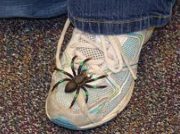
Spider on the Floor

Slide 36
There's a spider on the floor, on the floor.
There's a spider on the floor, on the floor.
Who could ask for anything more than a spider on the floor.
There's a spider on the floor, on the floor.
Now the spider's on my leg, on my leg. ...
Oh, I wish I had some Raid for this spider on my leg! ...
Now the spider's on my chest, on my chest! ...
Oh, I'd squish him in my vest, if it didn't make a mess! ...
Now the spider's on my neck, on my neck! ...
Oh, I'm gonna be a wreck, I've got a spider on my neck! ...
Now the spider's on my face, on my face! ...
Oh, what a big disgrace, I've got a spider on my face! ...
Now the spider's on my head, on my head! ...
Oh, I wish that he were dead. I've got a spider on my head! ...
SPOKEN: "But he jumped off.... "

Slide 37
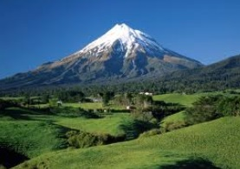
She’ll be Coming Round the Mountain

Slide 38
She'll be comin' 'round the mountain when she comes. (Whoo, whoo!)
She'll be comin' 'round the mountain when she comes. (Whoo, whoo!)
She'll be comin' 'round the mountain, comin' 'round the mountain
She'll be comin' 'round the mountain when she comes. (Whoo, whoo!)
She'll be driving six white horses, when she comes (Whoa, back!) . . .
She'll be driving six white horses, when she comes (Whoa, back! Whoo, Whoo!)
Oh, we'll all go out to meet her when she comes (Hi babe!) . . .
She'll be wearing silk pyjamas when she comes [Wolf whistle] . . .
And, we'll wear our bright red woollies when she comes (Scratch, scratch!) . . .
Oh, we'll kill the old red rooster, when she comes (Hack, hack!) . . .
Oh, we'll all have chicken and dumplings when she comes (Yum, yum! / Yuck, yuck!) . . .
Oh, we'll all have indigestion when she comes (Burp, burp!) . . .
Oh, she'll have to sleep with Grandma when she comes (Snore, snore!) . . .
Oh, she'll have to sleep with Grandma when she comes (Snore, snore!) . . .
Oh, she'll have to sleep with Grandma, she'll have to sleep with Grandma,
She'll have to sleep with Grandma when she comes (snore snore, burp burp, yum yum, hack hack, scratch scratch, [wolf whistle], Hi babe!, Whoa! Back!, Whoo Whoo!)

Slide 39
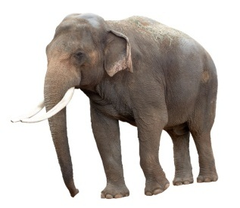
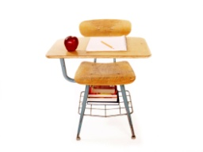
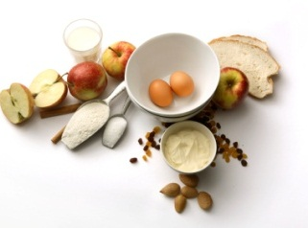
Vocabulary Practice
1. Choose your theme:
school
animals
food
sport
music
transport
occupations

Slide 40
Vocabulary - animals
Choose 5 – 10 words
elephant
monkey
zebra
crocodile
rhino
kangaroo
lion
bear
snake

Slide 41
Count the syllables in each
Choose 5 – 10 words
3
2
2
elephant
monkey
zebra
3
3
2
crocodile
rhino
kangaroo
2
1
1
lion
bear
snake

Slide 42
Choose a 2, 3, 1
zebra
crocodile
snake
Zebra, crocodile, snake *
Zebra, crocodile, snake *
Zebra, crocodile, zebra, crocodile,
Zebra, crocodile, snake *

Slide 43
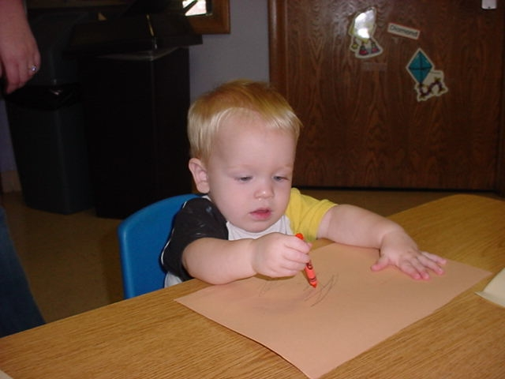
Grammar Chant - echo
Teacher: Write! Write!
Students: Write! Write!
Teacher: Who writes?
Students: Who writes?
Teacher: He writes.
Students: He writes.
Teacher: What does he write?
Students: What does he write?
Teacher: He writes his homework every day.
Students: He writes his homework every day...

Slide 44
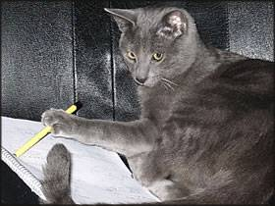
Grammar Chant – Q & A
Teacher: Write! Write!
Students: Write! Write!
Teacher: Who writes?
Students: He writes.
Teacher: What does he write?
Students: He writes his homework every day...

Slide 45
Grammar Chant – Q & A
Write! (clap-clap) Write! (clap )
Write! (clap-clap) Write! (clap )
(clap) Who writes? (clap)
He (clap-clap) writes! (clap)
What does he write? (clap)
He writes homework (clap clap-clap clap clap) every day.

Slide 46
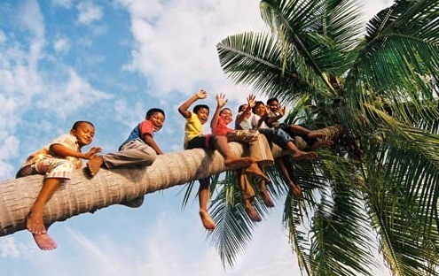
What are they saying?

Slide 47
Make a Grammar Chant
Write a few sentences of conversation between the boys in the tree and maybe someone (Mum?) on the ground.
Make it into a chant.

